Slide 1
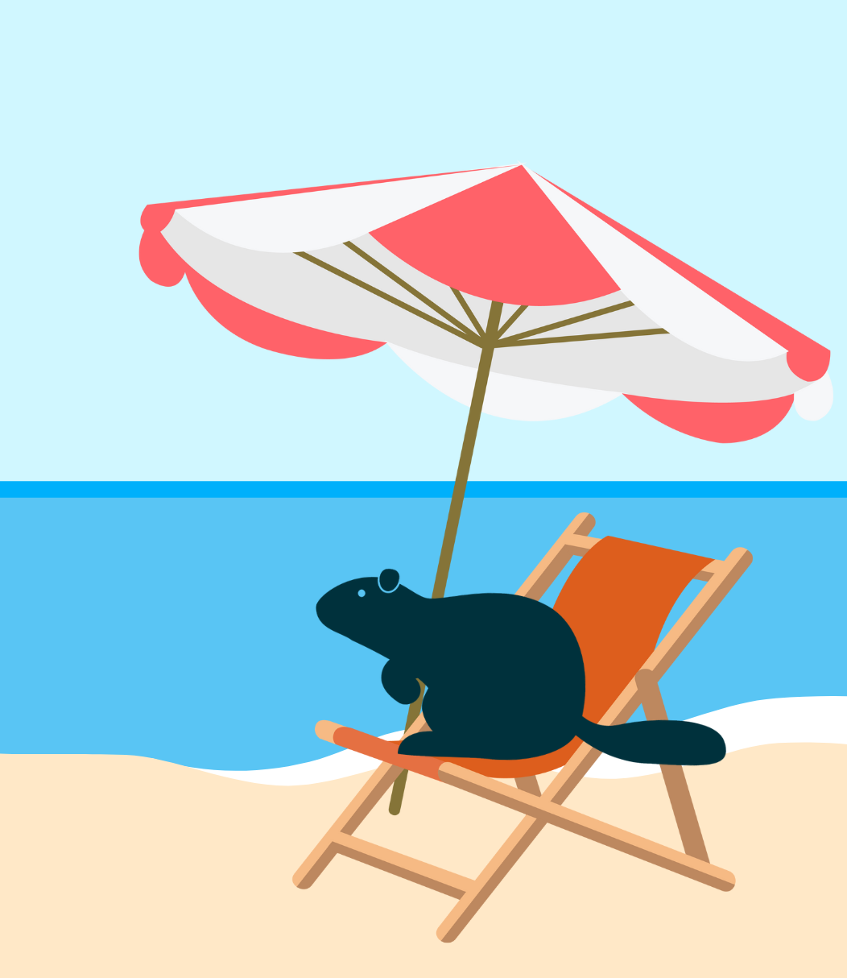
Bebras Mega Challenge – Holidays!
Notes:
** Please note there is also a lesson plan that accompanies this PowerPoint **

Slide 2
Challenge description
You're about to go on your overseas dream holiday - how exciting! Your job today is to create a detailed itinerary for the holiday. Use the six Bebras computational skills to complete this challenge.

Slide 3
Scenario/Factors to consider
You are planning to go on this holiday with a friend. You have both saved $7000 each and have two weeks of holiday leave available.
You are both adventurous people who like to do activities and explore, so you plan on having multiple stops.
Your friend has not gone on an overseas holiday before and you have kindly offered to provide them with instructions on what they need to organise.
$14 000 budget
Two people
Overseas holiday
Multiple stops
Create instructions for a friend
Notes:
Dependent on the age of your students and their current skill levels, you may wish to adjust the parameters of this task.

Slide 4
Brainstorming
Notes:
Example task and corresponding CT thinking skills
Decomposition – planning a holiday is all about breaking a task down into smaller more manageable parts e.g. basic time line, list of activities, food budget, activity budget, job list.
Algorithmic thinking - working out what tasks need to be completed in what order and identifying which tasks are dependent on others. E.g. Holiday dates –> overall budget --> passports --> visas --> travel --> accommodation --> activities --> packing.
Abstraction: Identify what information is relevant, prioritise, for example, what activities need to be cut if the budget does not allow etc
Modelling – creating and recreating itineraries.
Pattern recognition - Planning flights by looking for patterns in costing (e.g. cheaper on the weekend) deciding when to travel by looking at seasons and the popularity of a destination, deciding where to stay based on reviews.
Evaluation - deciding what went well and what can be improved in the planning process.

Slide 5
Discuss your holiday!
How did you approach planning this holiday?
Which element of the holiday was the most difficult to plan? Which was the easiest?
What would you do differently if you were to redo this activity?
What CT skills did you use?

Slide 6
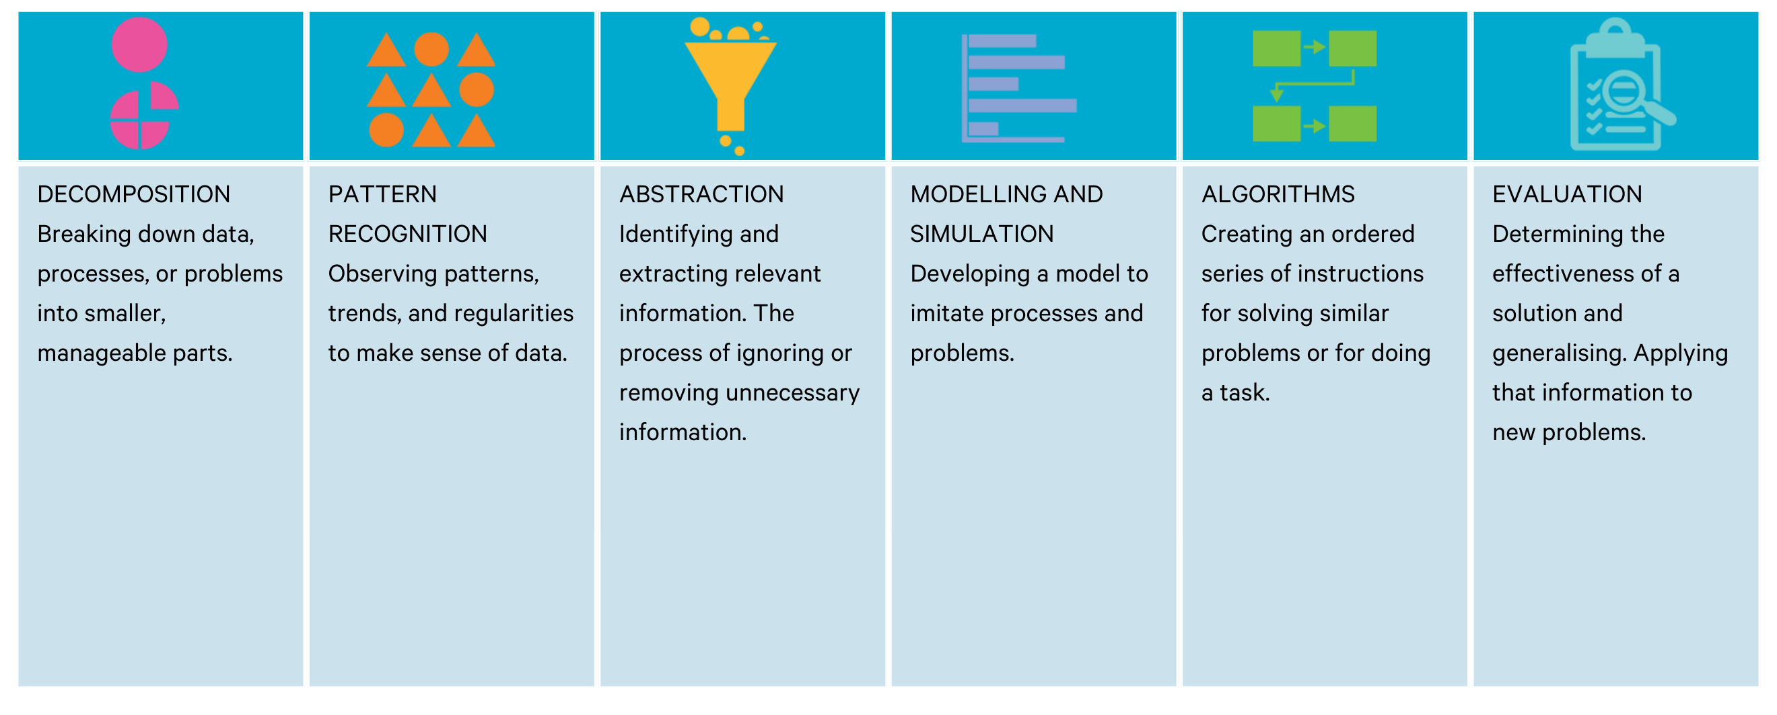
Computational Thinking Skills

Slide 7
Mission complete!

