Slide 1

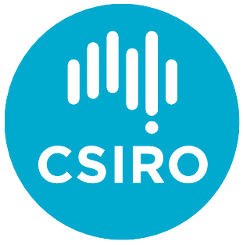











Australian Research Leadership in the Global Power System Transformation (G-PST)
Our Global Energy Transition
The world is undergoing a rapid, clean energy transition at unprecedented scope and scale. Making the transition requires collective problem solving across the value chain – from academia, to industry experts, to global system operators.
Solving these challenges is urgent and vitally important for Australia, and the world.
Australian scientists and researchers have an opportunity to lead the way, ensuring energy security for Australia during the energy transition, while creating jobs, investment, export opportunities and earning global recognition.
The need for action
Due to decentralisation, increasing variability, and step changes in energy sector technology, we are fast approaching an inflection point in the Australian energy transition.
A huge body of work is underway and must continue to deliver the needed end-state during this decade.
This work will be essential for solving Australia’s major energy transition challenges. Australian findings will also apply to energy sectors across the world.
The G-PST and Australia’s Leadership
The G-PST Consortium aims to dramatically accelerate the transition to low-emission and low-cost, secure, and reliable power systems.
The G-PST Consortium connects leading organisations across the world to identify common research questions aimed to inform large-scale national research and development investments.
Commonwealth Scientific and Industrial Research Organisation (CSIRO) and Australian Energy Market Operator (AEMO) are Australian representatives in the global consortium brought together to solve the challenges of integrating renewable energy into electricity networks and accelerating their decarbonisation, globally.
CSIRO and AEMO are driving local Australian know-how to create part of the solutions for the G-PST established research agenda in nine identified research topics over the past six months.
For more information about CSIRO and AEMO’s work within the G-PST please visit: https://globalpst.org
Why Invest in This Research Now?
Security
Facilitate a safe, cost-effective energy transition for consumers
Research
Advance critically needed Australian research
Innovation
Drive technology and innovation leadership
Investment
Create more stability and opportunity for investors
Export
Build an Australian powerhouse of exportable energy solutions
Environment
Support achievement of Australian net-zero emission goals
Australian Research Focus Topics
Inverter Design – Development of capabilities, services, design methodologies and standards for Inverter-Based Resources (IBRs) to ensure power system reliability.
Stability Tools and Methods – New tools and methods are required to ensure reliability, security and stability in power systems with more IBRs and traditional synchronous machines being phased out in the future.

Slide 2
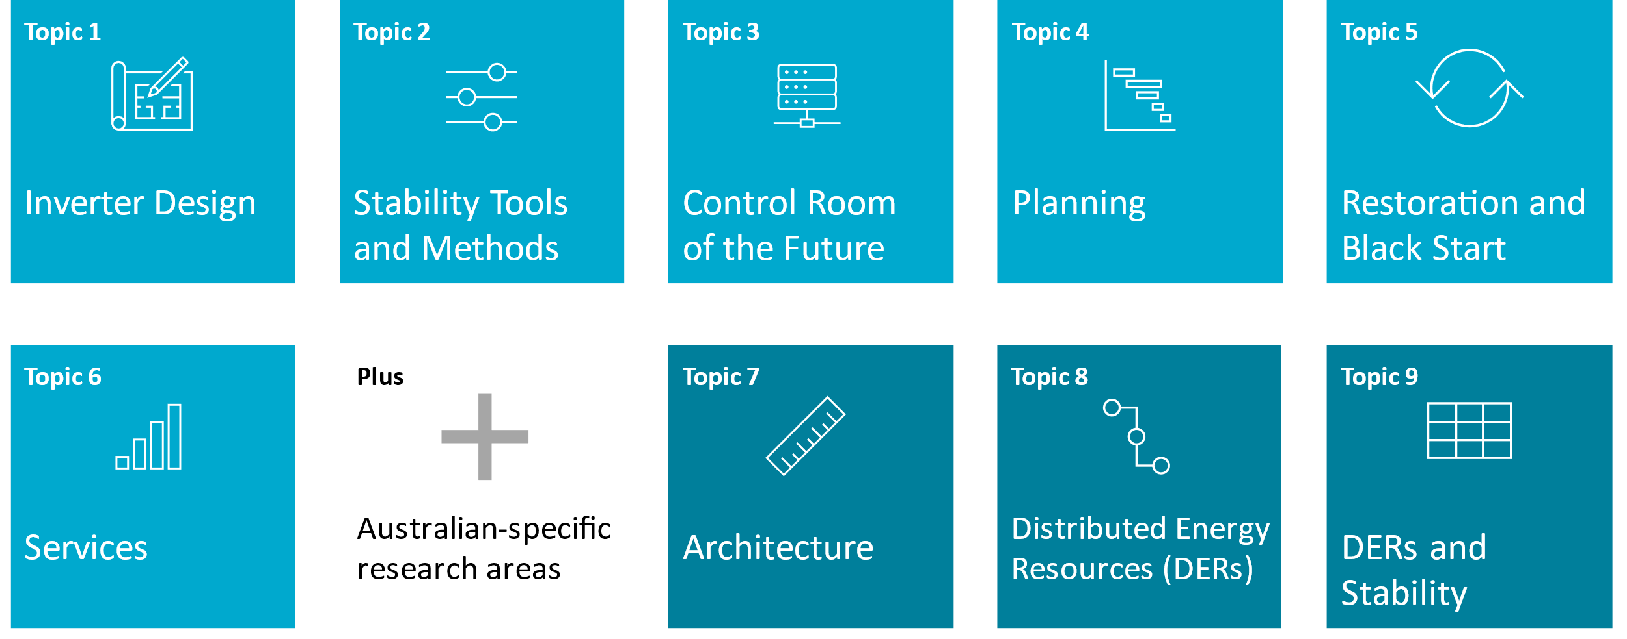

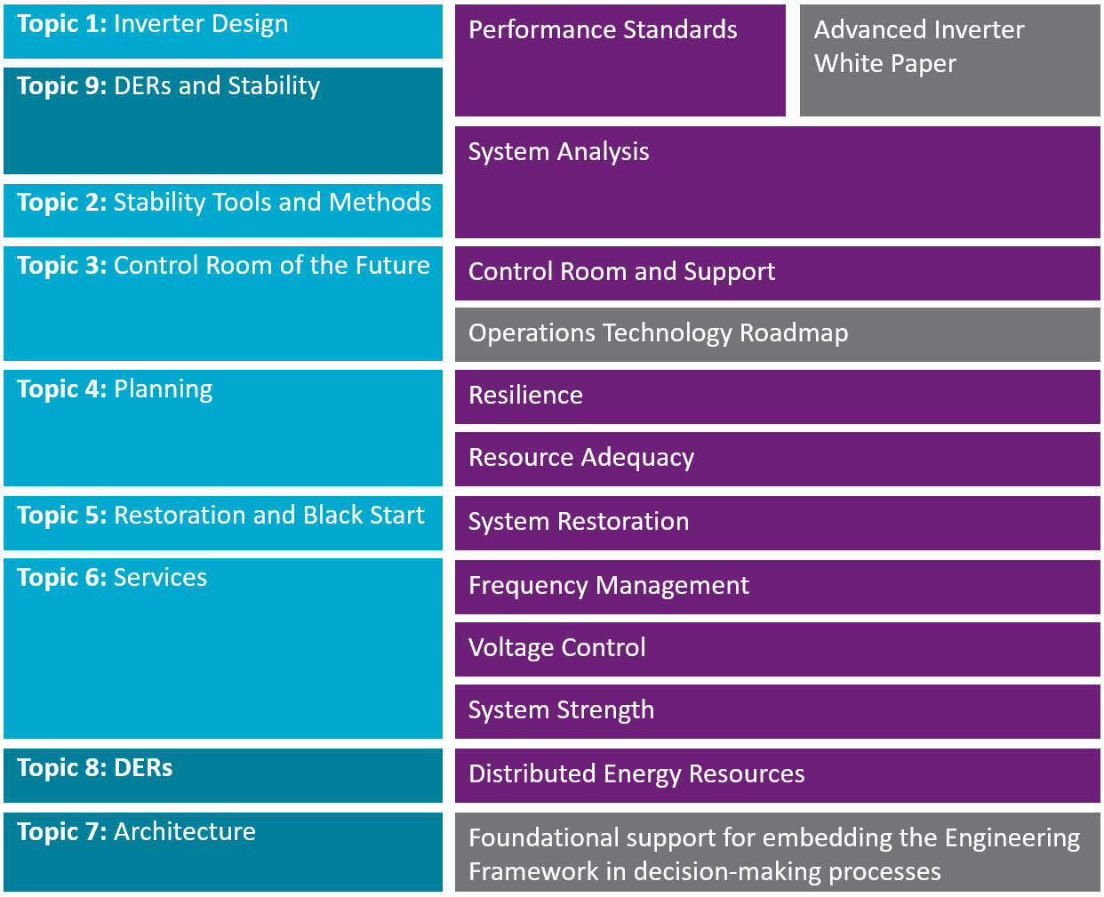
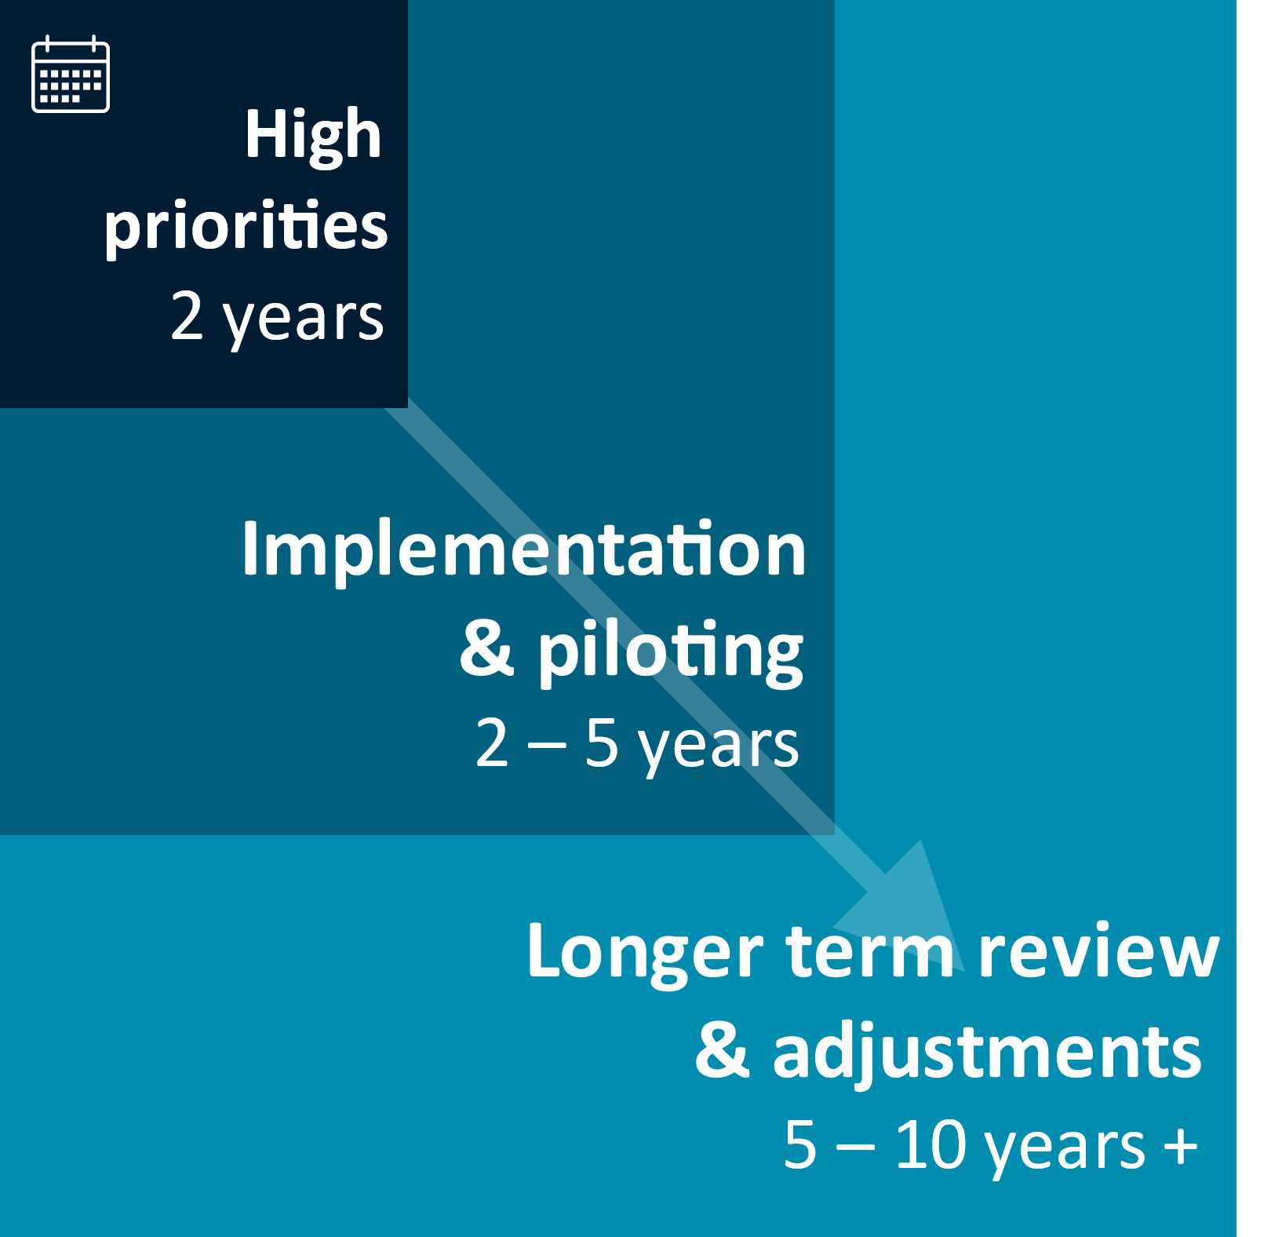
Control Room of the Future – Development of new technologies and approaches for enhanced real-time visibility and analysis in power system operator control rooms.
Planning – New planning metrics, methods, and tools to capture the characteristics and influence of a changing resource mix.
Restoration and Black Start – Creating new procedures for black starting and restoring a power system with high or 100% IBR penetration.
Services – Quantifying the technical service requirements of future power systems to maintain the supply-demand balance reliably and at least cost as higher penetration of renewables.
Architecture – Identifying appropriate future power system architectures for coordinating new technology capability, regulatory approaches, market design, and the distribution/transmission interface in a highly distributed, variable renewable energy-based system to support an orderly power system transition.
Distributed Energy Resources (DERs) – Investigating the challenges and opportunities from very high levels of DERs to make power system control and operation more effective.
DERs and Stability – Modelling and analysis of DER responses to ensure system operators can maintain power system security under very high DER penetration.
Topics are cohesive, and coordination is necessary to fully benefit the decarbonisation of power systems, in Australia and globally.
Complementary Interaction
This research aligns with the AEMO’s National Electricity Market (NEM) Engineering Framework, a roadmap to enable a secure and efficient energy transition.
G-PST Topics
AEMO’s NEM Engineering Framework
Find more information about AEMO’s NEM Engineering Framework at: https://aemo.com.au/en/initiatives/major-programs/engineering-framework
What’s Next?
There is a huge body of work needed across the industry over the next 10 years, which will necessitate a material uplift in the depth and breadth of power system engineering expertise both in academia and industry, for which the work by CSIRO helps build the foundation.
Research plans have been completed and are now ready for action.
An investment to facilitate the next big step of this research will take these plans from roadmap to reality.
As Australia’s national science agency and innovation catalyst, CSIRO is solving the greatest challenges through innovative science and technology. CSIRO. Unlocking a better future for everyone.
Contact us 1300 363 400 +61 3 9545 2176 csiroenquiries@csiro.au csiro.au
For further information Dr John K Ward, CSIRO Energy +61 2 4960 6072 John.K.Ward@csiro.au csiro.au/energy

