Slide 1


Fire-starting
CSIRO Education and Outreach
www.csiro.au/education
Notes:
Disclaimer: These resources are best used after, or alongside, teaching the focus area of the periodic table and atomic structure.

Slide 2
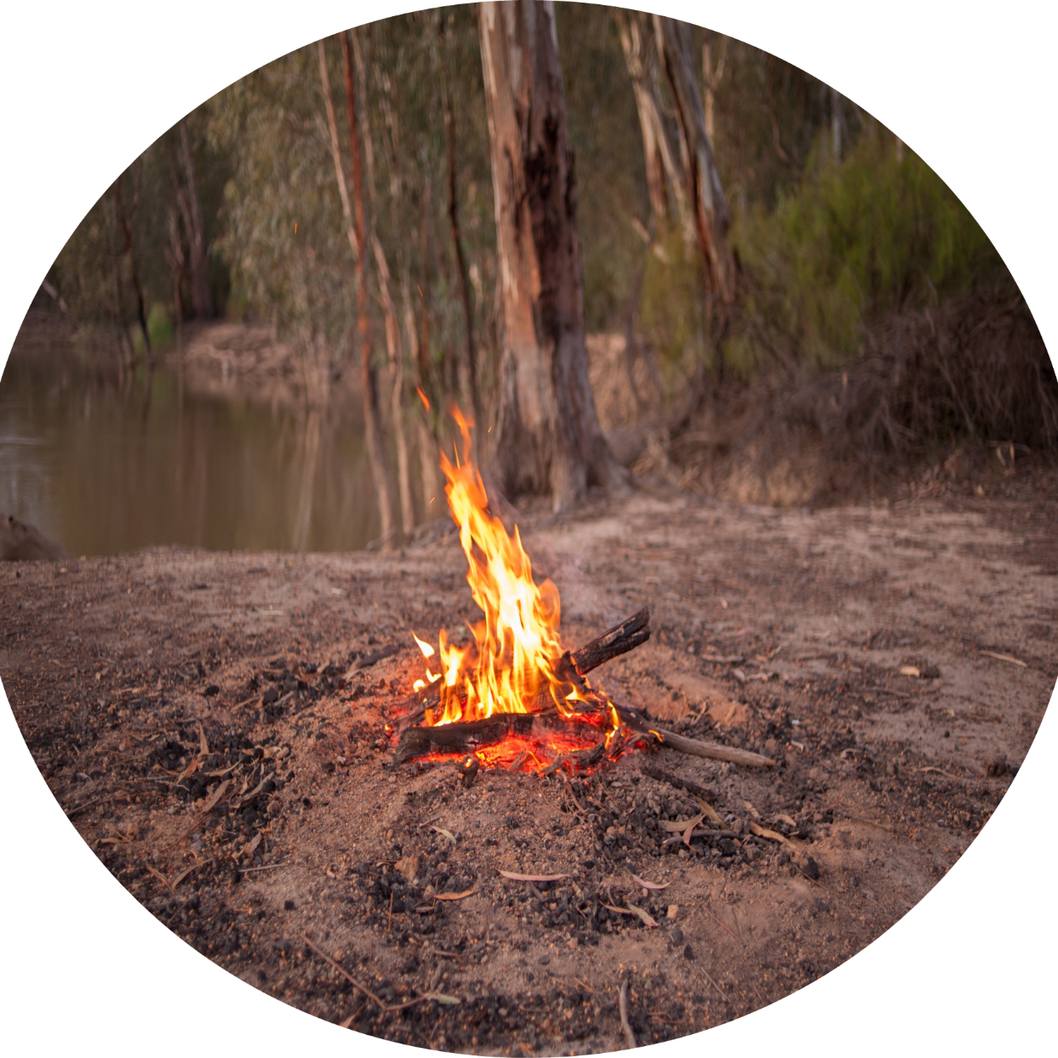
Lesson objectives
  Explore traditional use of fire by Aboriginal and/or Torres Strait Islander Peoples to manage natural environments.
  Understand abiotic and biotic ecosystem factors.
  Identify effects of fire on ecosystems.

Slide 3
ENERGY
  The ability to make things happen or cause change.
  Energy comes in many forms, including heat, light, sound, electrical and potential energy.
  Energy is never created or destroyed but can be transferred or transformed.

Slide 4












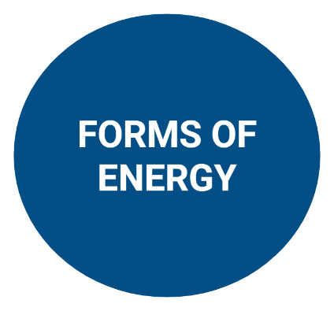

















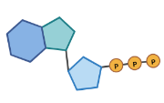
Forms of energy diagram
Notes:
Disclaimer: These resources are best used after, or alongside, teaching the focus area of the periodic table and atomic structure.
EXTENSION: What other forms of energy can you think of? (kinetic, elastic, geothermal)

Slide 5




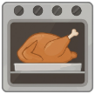
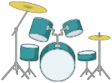



























Forms of energy diagram with examples
Notes:
Disclaimer: These resources are best used after, or alongside, teaching the focus area of the periodic table and atomic structure.

Slide 6

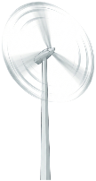
Potential vs kinetic energy
Potential energy
Energy that something has because of where it is or how it is set up. It is energy waiting to be used.
Kinetic energy
Energy something has because it is moving.
Examples
Light: carried by protons
Sound: from vibrating air
Mechanical: moving objects
Thermal: moving particles
Electrical: flowing charges
Electromagnetic: oscillate and travel
Examples
Gravitational: energy is about position
Chemical: is stored in bonds
Nuclear: energy comes from atomic structure
Electromagnetic: when the fields are static
Notes:
Disclaimer: These resources are best used after, or alongside, teaching the focus area of the periodic table and atomic structure.

Slide 7

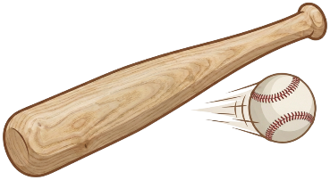
Energy
  Energy is never gained or lost but can be transferred or transformed.
  TRANSFER
  The movement of one energy form within or across objects or mediums in a system.
  The energy stays in the same form.
  For example, hitting a ball with the bat.
  TRANSFORMATION
  When energy in a system changes from one form to another.
  For example, turning on a light.

Slide 8
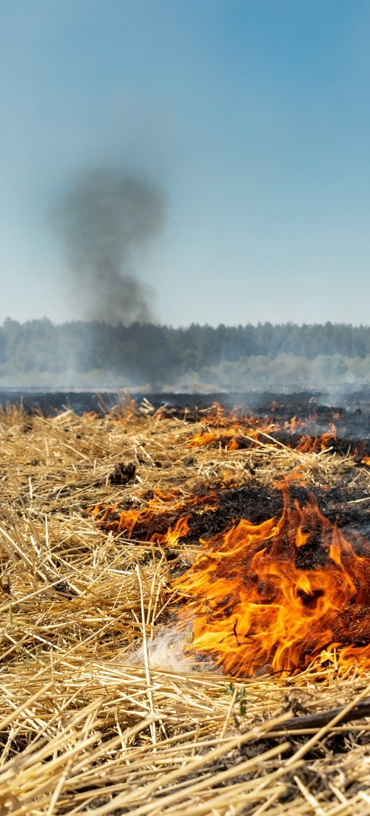
CHECK YOUR UNDERSTANDING
Think-Pair-Share
What energy form does the bat have when it strikes the ball?
What change in the ball does that energy generate?
What energy goes into the light bulb when it is switched on?
  What energy type/s does this energy transform into?

Slide 9
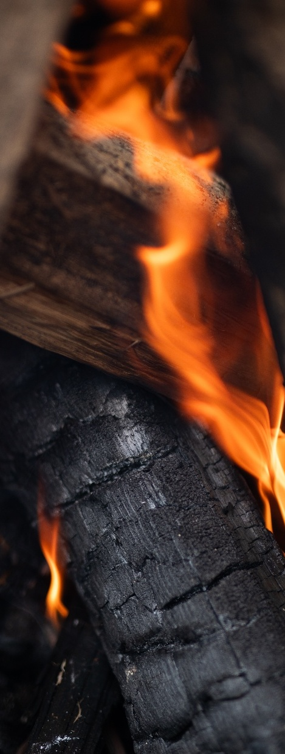
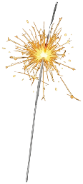


Energy systems,
transfers and transformations
Activity
Observe energy systems in action: sparkler, plant, and M&Ms.
Identify the energy type entering and leaving the system.
Draw a flow diagram to represent each energy system.
1. Sparkler
2. Plant
3. M&Ms
Notes:
Flow diagram answers on next slide

Slide 10






FLOW DIAGRAM ANSWERS
1. Sparkler
3. M&Ms
TRANSFORMED/
TRANSFERRED
2. Plant
TRANSFORMED
Chemical potential + thermal
light + sound + thermal
Chemical potential
mechanical + thermal
TRANSFORMED
Light
Chemical potential

Slide 11
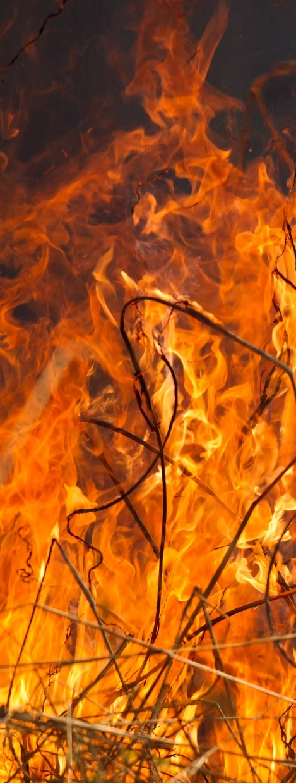
Investigate energy forms, transfers and transformations
Activity
In groups, you will observe a range of energy systems.
Write your answers in the Classroom activity 2 worksheet (Fire-Starting).
At each station: | As a class, reflect and discuss:
Identify the energy source entering the system. Identify energy outputs. Decide whether energy is transferred, transformed, or both. Draw a labelled energy flow diagram. Identify any wasted energy. | Which energy form were we trying to observe in each system? Were there other forms of energy produced? What do we call energy that is not useful in the system? Which systems seemed more efficient? Why?

Slide 12
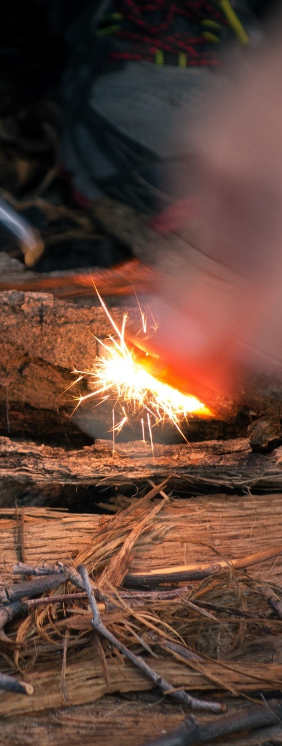
Fire-starting knowledge
  Aboriginal peoples and/or Torres Strait Islander Peoples use different fire-starting methods across regions, based on the local environment and available resources.
  Fire-starting practices are guided by deep ecological knowledge, including:
    Understanding plant materials and their properties.
    Knowing when materials are dry enough to use.
    Knowing the right weather conditions to make and maintain a fire.

Slide 13
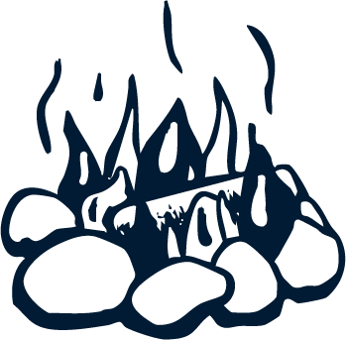
Traditional use of fire
Fire was and still is important in the life and culture of Aboriginal and/or Torres Strait Islander peoples.
Fire has a number of uses including:
TO HUNT
TO COOK
TO MAINTAIN SPIRITUALITY AND CONNECTION TO COUNTRY
TO PROTECT SACRED SITES
TO ENCOURAGE PARTICULAR
PLANTS TO GROW
TO CLEAR COUNTRY
FOR WARMTH
FOR CEREMONY
FOR SIGNALLING

Slide 14
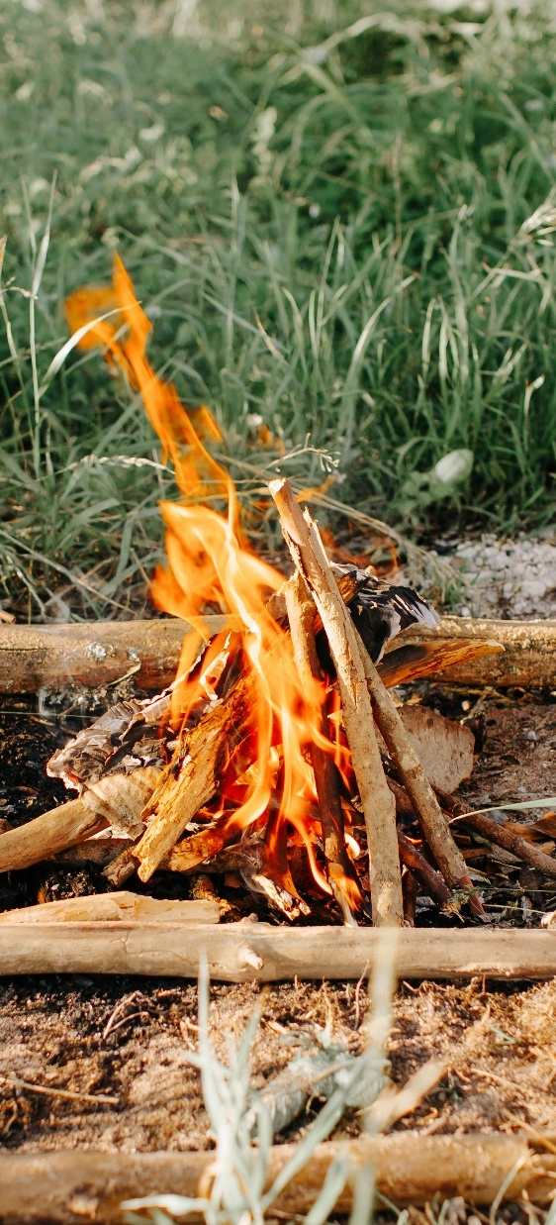
Traditional fire-starting methods
    ​Hand drill (fire drill)​
    Fire saw
    Fire plough​
    Percussion​

Slide 15
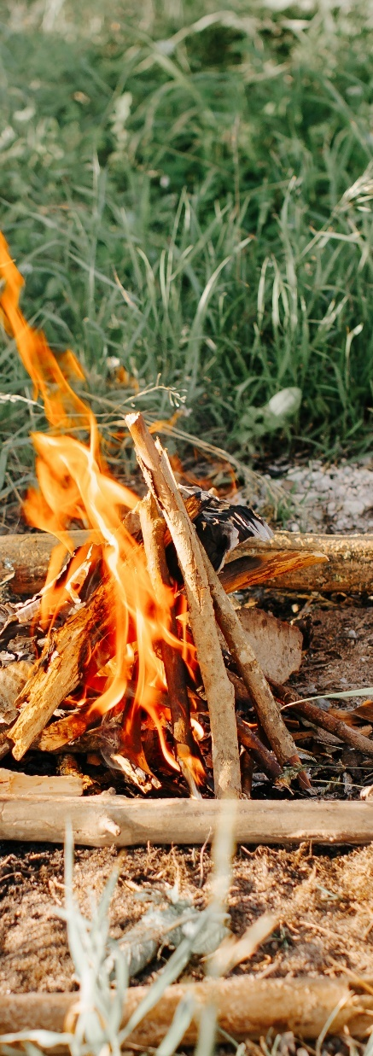

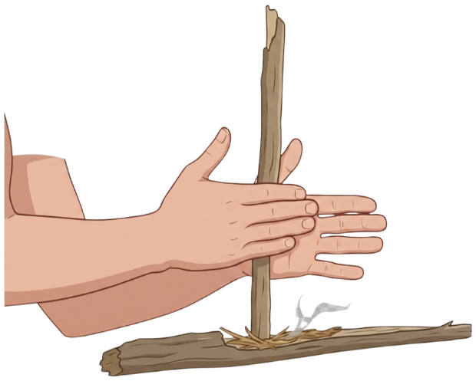

Hand drill method ​
The hand drill (fire drill) is the most common traditional fire-starting method in Australia.
It uses two pieces of dry wood: a drill stick and a hearth (board) stick.
METHOD:
The drill stick is placed in a small notch on the hearth board.
The drill stick is spun between the hands while pressing down.
As the hands move up and down the stick, friction creates heat and fine wood dust.
The heat causes the wood dust to smoulder and form an ember.
The ember is then used to light tinder and start a fire.
Drill stick
Hearth board
Notes:
Example of hand drill method - https://youtu.be/yHj_lkCIO88

Slide 16
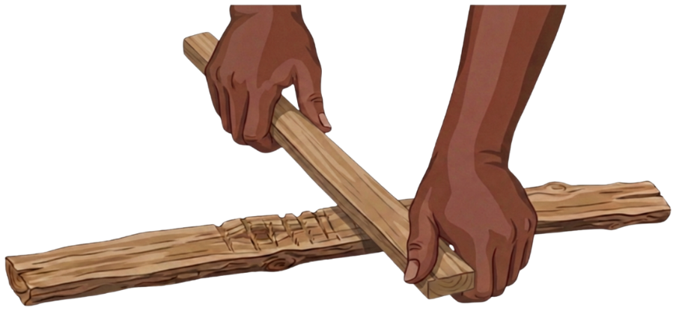

Fire saw technique
Widely used across central Australia and the north-west coastal regions
Uses existing tools and materials
The saw stick has a sharp edge; the hearth stick has a groove
METHOD:
Place the saw stick into the groove of the hearth stick.
Hold the saw stick with both hands and move it back-and-forth while pressing down.
Friction creates heat and fine sawdust.
The sawdust smoulders to form an ember.
The ember is used to ignite tinder and start a fire.
Saw stick
Hearth stick
Notes:
Example of fire saw method - https://youtu.be/eNuop9T8itg

Slide 17
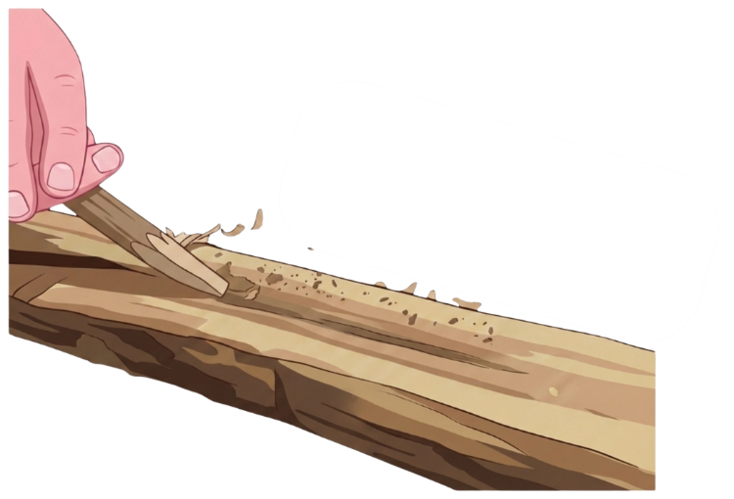
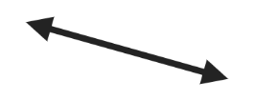
Fire plough method
A fire plough consists of a long piece of dry wood with a groove cutdown its length and a dry stick with a dull end that is used as the ‘plough’.
The stick is rubbed along the groove in a ploughing motion until an ember is produced​ and ignites the tinder.
Stick
Plough
Notes:
Example of fire plough method - https://youtu.be/9cjfx6gEyhg

Slide 18
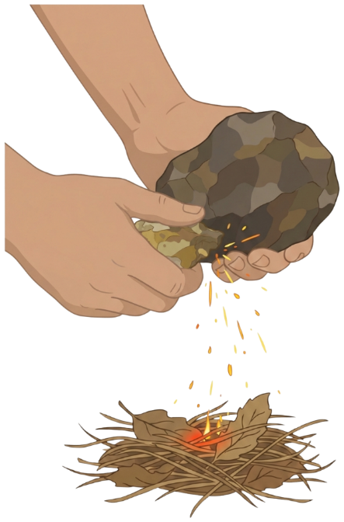

Percussion method
​The flint stone is used to strike iron stone, causing sparks to fly off and ignite the tinder​.
The striking stone is called: tur:u’tu’la (tur:u – fire; ‘tu’la –stone).
Flint
Iron stone
Tinder
Notes:
Example of percussion method - https://youtu.be/r-KRufzP6Dw

Slide 19
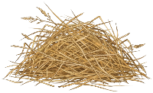





ROLE OF TINDER
A material that is very dry and easily catches on fire.
When you create sparks or heat (from friction), the tinder catches fire first.
Once tinder is burning, it can be used to light other materials that are harder to ignite.
Acts as the “helper” for starting a fire. Without it, starting a fire is much harder.
Examples include:
DRY GRASS
  BARK
      DRIED ANIMAL
      DUNG
EUCALYPTUS
LEAVES
COCONUT
FIBRE

Slide 20
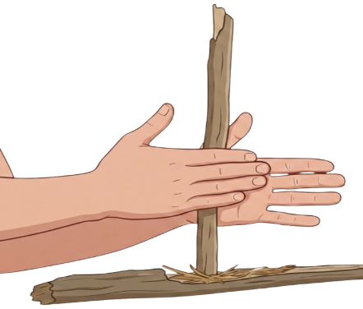
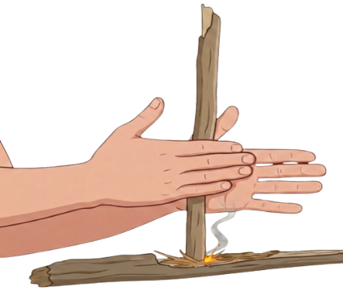
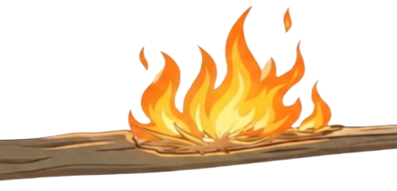
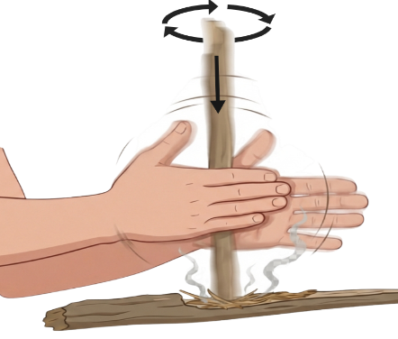
FORMS OF ENERGY IN FIRE-STARTING
1.
3.
4.
2.
CHEMICAL POTENTIAL ENERGY
Energy stored in wood, tinder, a person’s muscles.
HEAT ENERGY
Friction creates heat and forms an ember.
LIGHT AND HEAT ENERGY
Fire burns and gives off visible flames.
KINETIC & SOUND ENERGY
Person moving saw/drill stick.

Slide 21
1. Check your understanding
CHECK YOUR UNDERSTANDING
Think-Pair-Share
What forms of energy are used in the fire making process?
Describe one energy transfer and one energy transformation that occurs during the fire-making process.

Slide 22
2. Check your understanding
CHECK YOUR UNDERSTANDING
Think-Pair-Share
What is common between the different techniques?
Where does the heat/smoke come from?
How is the energy coming into the system to create heat?

Slide 23
Check your understanding – multiple choice
CHECK YOUR UNDERSTANDING
Multiple Choice
Woods used in traditional fire-starting methods need to be chosen carefully.
Choose all the answers that are correct.
Dry wood helps create enough friction to produce heat.
Wood that is too soft or rotten can crumble and stop friction from building.
Wet wood burns faster and creates more heat.
Best results come from having a hard drill stick and softer hearth board.
All the above.
Notes:
Answer on next slide.

Slide 24
Check your understanding – answers
CHECK YOUR UNDERSTANDING
Multiple Choice
Woods used in traditional fire-starting methods need to be chosen carefully.
Choose all the answers that are correct.
Dry wood helps create enough friction to produce heat.
Wood that is too soft or rotten can crumble and stop friction from building.
Wet wood burns faster and creates more heat.
Best results come from having a hard drill stick and softer hearth board.
All the above.

Slide 25
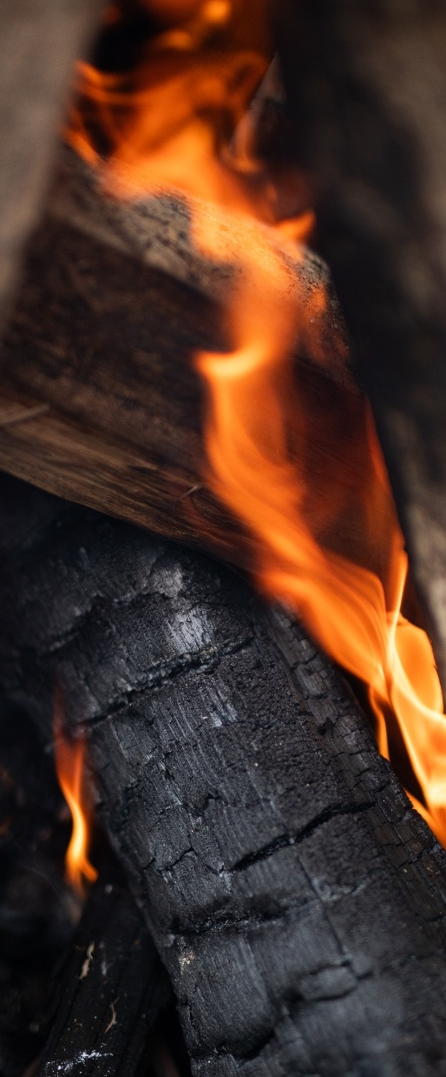
ENERGY FLOW CHART
Activity
Using your knowledge of how fire is started using the hand drill or fire saw method, create an energy transformation flow chart.
For each step in the flow chart:
Write the stage of the fire-starting method (what is happening at that point).
Identify the type of energy involved: chemical potential energy, kinetic energy, heat energy, light energy or chemical energy.
Identify if the energy is being transferred or transformed across each step.
Notes:
Flow chart template on next slide (optional to use)

Slide 26

Energy flow chart – template option
ENERGY FLOW CHART
TEMPLATE OPTION:
TRANSFORMED/
TRANSFERRED
TRANSFORMED/
TRANSFERRED
TRANSFORMED/
TRANSFERRED
Energy type
Energy type
Energy type
Energy type
Fire-starting step
Fire-starting step
Fire-starting step
Fire-starting step
Notes:
Answers on next slide.
OPTIONAL: Complete flow diagram on an interactive white board.

Slide 27
Energy flow chart - answers
ENERGY FLOW CHART
ANSWERS:
TRANSFORMED/
TRANSFERRED
TRANSFORMED/
TRANSFERRED
TRANSFORMED/
TRANSFERRED
Chemical potential energy
Kinetic energy
Heat energy
Heat and light energy
Energy stored in wood, tinder, a person’s muscles.
Muscles moving saw/drill stick.
Friction creates heat
and forms an ember from dust.
Ember ignites hearth and fire burns.

Slide 28
KNOWLEDGE CHECK
Name one traditional fire-starting method used by Aboriginal and/or Torres Strait Islander Peoples.
Explain how movement and friction change kinetic energy into heat energy to start a fire.
Draw a simple flow diagram showing energy transfers and transformations during fire-starting. Identify the types of energy involved (kinetic, heat, chemical, potential) at each stage.
Where is the chemical energy stored before the fire burns and how is it released?

