Slide 1
Space Careers Wayfinder
Forces and Newton’s Laws
The number of objects reported to be floating around in space vary, but scientific models estimate around 27 000 objects larger than 10 cm. As we add to this number the likelihood of a collision increases. The US Space Surveillance Network (SSN) monitors the majority of these objects and advises relevant parties of any potential impacts. Depending on the probability of a collision any craft likely to be impacted can be manoeuvred out of harm’s way.
Neumann Space have developed a propulsion system which is capable of carrying out such evasive manoeuvres on small CubeSat sized satellites. The propulsion system is unique in utilising a solid metallic rod as propellant. The metallic rod can be made on Earth and in space from any solid conductive metal or alloy, including the various metals already in orbit around the Earth.
Newton’s laws of motion
A rocket leaving the Earth’s surface does so as a result of the immense energy from the hot gases expelled through the nozzles of the engines. Propulsion systems which may not have the capacity to launch a craft into space from Earth may well find application under different conditions. Neumann’s Drive is one such in space propulsion system. The system developed by Neumann Space produces a plasma from a solid metal fuel. The generated plasma is then used to provide thrust and propel the craft.
Why is it possible to move a craft in space with a propulsion system of much lower output than needed to get the craft out into space?
A propulsion system capable of launching a craft from Earth into space has to overcome the planet’s gravitational pull and frictional forces. Once in space the craft is no longer exposed to the same level of gravitational force and friction (due to air resistance).
2. Earth orbiting craft such as satellites including the International Space Station are monitored closely by ground stations. Should the craft begin to deviate from its planned trajectory an onboard propulsion system is initiated to correct the deviation. During the correction process which of Newton’s Laws of Motion apply? Assume the craft is travelling at a constant speed. Explain your choice.
1st law - Every object will remain at rest or in uniform motion unless compelled to change its state by the action of an external force.
Without correction, it will continue on the deviated path.
2nd law - The acceleration on an object is proportional to the applied force and inversely proportional to the mass.

Slide 2
Forces and Newton’s Laws – page 2
Applying an external force via a thrust correction is required to correct the deviated path. It causes an acceleration via a directional change and/or change in speed.
3rd law - For every action there is an equal and opposite reaction.
As gas is thrust out in one direction (via either burning fuels or compressed gas) it pushes the object in the other direction.
Newton’s First Law
3. A spacecraft travelling at a constant velocity on course for the Earth’s Moon begins to change velocity as it approaches the surface of the Moon. The change in velocity becomes more pronounced as the craft gets closer to the surface of the Moon, all this happens without any input from the crew. What could be causing the change in velocity and how does this relate to Newton’s 1st Law?
The gravitational force of the Moon can be felt at any distance, as gravity is a force that extends infinitely into space. However, the strength of the Moon's gravitational force decreases with distance from the Moon.
To give you an idea, the gravitational force of the Moon is about one-sixth (1/6) the strength of Earth's gravitational force.
The distance at which the Moon's gravity is strong enough to have a noticeable effect on an object's motion depends on the mass of the object and its distance from the Moon. For example, the tides on Earth are caused by the gravitational pull of the Moon, which is strongest at the point on Earth closest to the Moon.
In terms of distance, the point where the gravitational force of the Moon is strongest is at the surface of the Moon itself. At an altitude of 100 km above the Moon's surface, the gravitational force is only about 83% of the force at the surface. At a distance of 1,000 km from the Moon's surface, the gravitational force is only about 0.008% of the force at the surface.
4. If you were travelling in the spacecraft towards the Moon at a constant speed of 32 000 km/h and your friend in their spacecraft is travelling at a constant speed of 20 000 km/h. Who is experiencing the greater acceleration?
a. You
b. Your friend
c. Neither you nor your friend
c. Both are travelling at a constant speed – no acceleration.
5. Which one of the following best describes Newton’s First Law?
a. Every action has an equal reaction
b. Objects tend to stay at the same velocity unless an external force acts on it
c. Acceleration of an object is proportional to the force
d. A force that holds an object in orbit
b. A body at rest or moving at a constant speed in a straight line, will remain at rest or keep moving in a straight line at constant speed unless it is acted upon by an external force.

Slide 3
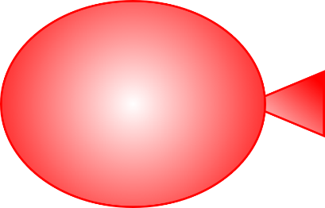
Forces and Newton’s Laws – page 3
Newton’s Second Law
Watch this NASA “STEMonstrations” video on the demonstration of Newton’s Second Law on the International Space Station.
6. If you apply the same force of 100 N to three different objects with masses 1 g, 1 kg, and 100 kg respectively, then determine the resultant acceleration in each case and fill in your answer in the table below:
Mass (kg) | Acceleration (m/s²)
0.001 | 10 000
1 | 100
100 | 1
Describe the relationship between mass and acceleration.
As the mass of an object is increased, the acceleration of the object decreases with the same applied force.
Does this make sense? In your answer refer to Newton’s First Law.
Yes. As an object with mass has a resistance to an external force (i.e., inertia). If the same amount of force is applied, then the resultant acceleration will be dependent on the object’s mass, making it harder to move heavier objects.
Newton’s Third Law
Imagine an inflated balloon full of air where the hole is currently being pinched.
a. Identify the action/ reaction pair of forces on the image below when the balloon is released.
REACTION
Balloon propelled
In opposite direction
ACTION
Air being pushed
Out of the hole of the balloon

Slide 4
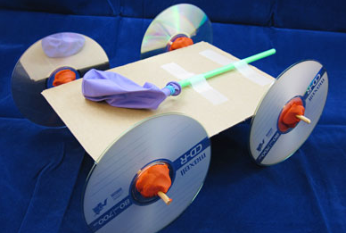
Forces and Newton’s Laws – page 4
Hands-on activity: Balloon cars
Materials
Balloon
Cardboard – for body
Cardboard – for wheels (alternative: bottle tops, CDs)
1 straw, x2 BBQ skewers
Sticky tape
Blu tack
Scissors
Instructions
Cut the cardboard into a rectangle, where the width is just shorter (20 mm-30 mm) than the length of a straw or skewer – this becomes the ‘body’ of the car
Cut four equal sized circles with the cardboard. Puncture a hole in the centre of each circle or fill the bottle top with Blu tack. These will be the ‘wheels’
Cut the straw in half. These straws become the housing of the ‘axles’. Tape the straw axles down near the ends of the body of the car
Insert skewers into both axle housings. Attach the wheels to the ends of the skewers
Attached balloon’s hole over a straw using sticky tape and attached on the top rear end of the body of the car, such that the straw becomes the ‘exhaust pipe’
Blow up balloon via straw
Place car on the ground and let it go
Think about improvements in design and/or have fun by performing races with fellow students
Exercise using the Balloon car
Additional material:
Pen and paper / computer
Measuring tape
String
Instructions:
Blow up balloon to a particular size (e.g., quarter, half, three-quarters, or full)
Use string in combination with measuring tape to measure circumference of balloon after gently squeezing it into a more spherical shape (record in table)
Estimate the volume of the balloon using the volume of a sphere equation
V = 4/3 x π x radius³, where radius = Circumference/(2π) (record in table)
Calculate the volume of balloon (record in table)
Release balloon from starting location and measure distance travelled (record in table)
Repeats steps 1 – 5 for different balloon sizes as desired.
Plot values Distance travelled against Volume of balloon using pen and paper or computer. Determine which is the independent variable and the dependent variable.
https://www.sciencebuddies.org/XeADNH7x9cxhdbxlZ1qZ_xsLxNo=/400x300/-/https/www.sciencebuddies.org/cdn/Files/6747/7/balloon-car-CD.jpg
Approximate amount of air [suggested sizes] | Circumference of balloon [cm] | Radius of balloon [cm] | Approx. Volume of Balloon [cm³] | Distance travelled by balloon Car [cm]
Quarter full
Half full
Three quarters full
Full

Slide 5

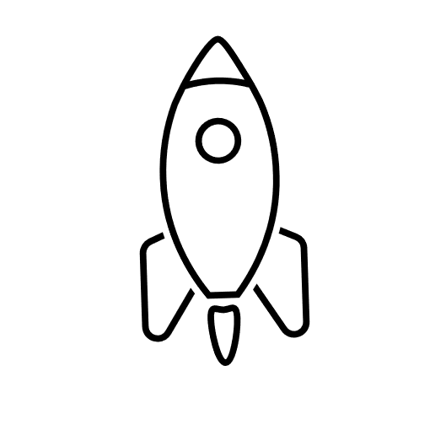
Forces and Newton’s Laws – page 5
Discussion questions:
What is the relationship between distance travelled and the volume of the balloon?
Distance travelled increases with increase in volume.
How does this relate to Newton’s Third Law?
For every action there is an equal and opposite reaction. In this case the car is propelled forward from the air rushing backwards out of the balloon.
What are variables that contribute to the uncertainty of the results?
Many - volume of air in balloon, surface friction and air friction, mass, decreasing elasticity of the balloon etc.
Safety
Hazard: Use of scissors
Potential harm: bodily injury Control: When using scissors always cut away from the body and fingers.
Classroom Activity 2: Space Travel
Skill focus: Problem solving
Draw force diagrams for a rocket in two situations:
a. At rest on the ground b. Travelling at constant speed
(Assuming only vertical motion)
Reaction force
Thrust
Weight
Weight + drag
If a rocket has a mass of 1000 tonnes plus a starting fuel mass of 500 tonnes:
a. Calculate the total rocket (+ fuel) weight at rest.
Weight = mass x acceleration due to gravity
W = mg
= (1000 + 500) x 1000 kg x 9.8 m/s²
= 14 700 000 N
b. For five minutes after take-off, the rocket expends all its fuel. Calculate the rocket’s thrust if it managed to keep a constant velocity of 6000 m/s. Ignore any drag components
Thrust = velocity x change in mass / change in time
T = v x dm/dt
= 6000 m/s x (500 x 1000 kg)/(5 x 60 s)
= 10 000 000 N

Slide 6
Forces and Newton’s Laws – page 6
Hands-on activity: Water rocket activity or stomp rocket activity (Optional if equipment is available)
Note: A number of launch kits are available through educational supplies for this activity.
NASA have an online example of a stomp rocket using pvc pipe and paper rockets https://www.youtube.com/watch?v=5bO8dpPuG4E
Safety
Hazard: Pressure build-up in plastic bottle to create projectile
Potential harm: bodily injury
Control: Always have a teacher and/or supervisor present and make sure any projectile is pointed away from people when ready to launch.
Wear safety glasses for this activitiy
Classroom Activity 3: Rocket Launch – Code Club Australia
Skill focus: coding
Rocket Launch – Code Club Australia
Rocket Launch | Code Club Australia
Additional resources
Space Technology Future Science Platform – CSIRO
Low Earth Orbit Visualization – LeoLabs, Inc (2023)
ESA’s Space Environment Report – European Space Agency (2022)
Space: A Roadmap for unlocking future growth opportunities for Australia – CSIRO (2018)
CubeSat – CSIRO (December 2018)
Centre for Earth Observation – CSIRO
Galileo & Newton – CSIRO/ATNF
What are Newton’s Laws of Motion? – NASA (October 2022)
What is Thrust? – NASA (July 2022)
Rocket Nozzle Interactive Simulator – NASA (August 2022)
SPACE CAREERS WAYFINDER IS A COLLABORATION BETWEEN
THE CSIRO AND THE AUSTRALIAN NATIONAL UNIVERSITY

