Slide 1


Space Careers Wayfinder
Humans in Deep Space
Background
From the second a crew enters a space craft they are faced with countless hazards and challenges. Even before the craft leaves the Earth’s surface, they find themselves atop huge cylinders filled with highly flammable fuels, typically around 400 000 kilograms or 300 000 litres. As the craft accelerates to a top speed in excess of 40 000 km/h crew members experience a gravitational force around 3 G, this is 3 times the force normally felt on the earth’s surface.
Once off the ground the crew face higher levels of radiation, the effects of microgravity, hostile space environments etc.
The task
Use the internet and other sources to complete the table on the next page identifying the hazards and challenges faced by a crew in deep space. These might have physiological and psychological effects. Describe how the risks are minimised.
https://www.youtube.com/watch?v=TZkuQUCUYgM

Slide 2
Humans in Deep Space – page 2
Hazard/Challenge | Effect/Impact | Mitigation!
Launch pad potential explosion/fire | Fatality, critical or severe injury. | Mission abort protocol. Launch pad water deluge systems.
Radiation | Cancer, central nervous system damage, cardiovascular disease, degenerative tissue defects. | Forecasting the Sun’s solar energetic particle ejections. Magnetic shields.
Earth’s gravitational force | Reduced flow of blood to the eyes. Reduced flow of blood to the head with possible blackout. | Gravity suit which contains an air bladder. Air bladder inflates preventing blood pooling in the feet and legs.
Collision with other objects in space | Fatality, critical or severe injury. | Track space debris and other active objects in space. Preventative measures and launch trajectories determined and implemented to avoid objects in space.
Microgravity | Loss in bone density and muscle mass. Increased fluids in the head causing vision impairment and increased pressure on the brain. | Aerobic and resistive exercise. Pressure cuffs/lower body negative pressure suit.
Hostile environment (Temperature and vacuum in deep space) | Air drawn from lungs causing suffocation, water in the body would boil with swelling of body tissue. | Environmental control and life support system. Temperature and pressure-controlled space suit with a built-in life support system.
Isolation | Cognitive dysfunction, behavioural changes, mental disorder. | Psychological screening and rigorous assessment including Temperament Structure Scale (TSS) and a NEO Personality Inventory-Revised (NEO PI-R) Intensive training in space analogue environments.
Medical situation/emergency | Injury, illness, possible fatality. | Training SMART medical systems including telemedicine. Flight surgeon who overseas health care and medical training of crew. And conducts weekly private medical conference with each crew member.
Water and food | Starvation, dehydration potentially fatal consequences. | Recycle urine and sweat. Extract CO₂ and process to make water and methane. Dehydrate food to reduce weight.
Breathable air and essential items | Suffocation from lack of oxygen, asphyxiation from contaminated air. Muscle and bone wasting | Initially liquid oxygen in tanks eventually splitting water into hydrogen and oxygen, air filtration system. Exercise equipment etc.
Personal hygiene and bodily functions | Dental caries, unpleasant odours, bacterial infections | Sanitisers, change of clothing, follow human waste disposal process and protocol.
Power supply | Life support systems fail, means of manoeuvring space craft lost. | Solar panels, batteries, fuel cells.
Navigation | Spacecraft and crew lost indefinitely resulting in fatality, collision with another object. | No GPS beyond medium Earth orbit. Sophisticated radios, large antennas, computers, and precise timing equipment. Pulsars are being explored as a means of navigation.
Communication | Psychological impact on crew, impact available support from groundcrew. | Deep Space Networks, development of optical communication systems using laser technology.
SPACE CAREERS WAYFINDER IS A COLLABORATION BETWEEN
THE CSIRO AND THE AUSTRALIAN NATIONAL UNIVERSITY

Slide 3
Space Careers Wayfinder
Identify and label effects of prolonged space travel on the human body
Identify the major organs/systems of the body which are affected by long term space flight. Use the internet to add images for the organ/system or sketch them on the body on the next page. Include the likely impact on the organ/system from long term space flight

Slide 4
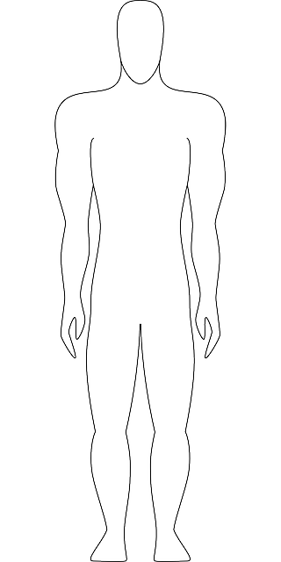




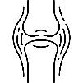

Identify and label effects of prolonged space travel on the human body – page 2
Radiation
Cancer, central nervous system damage, cardiovascular disease, degenerative tissue defects
Earth’s gravitational force
Reduced flow of blood to the eyes.
Reduced flow of blood to the head with possible blackout.
Hostile environment
(Temperature and vacuum in deep space)
Air drawn from lungs causing suffocation, water in the body would boil with swelling of body tissue.
Microgravity
Loss in bone density and muscle mass. Increased fluids in the head causing vision impairment and increased pressure on the brain.
All images courtesy of Flaticon.com
SPACE CAREERS WAYFINDER IS A COLLABORATION BETWEEN
THE CSIRO AND THE AUSTRALIAN NATIONAL UNIVERSITY

