Slide 1
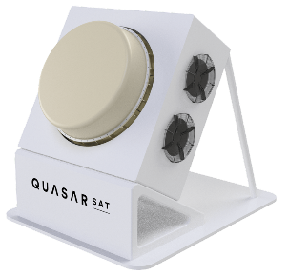

Space Careers Wayfinder
Identifying Your Market
The product developed by Ilana and the team at Quasar Satellite Technologies can definitely be considered innovative. But what is innovation?
There are many forms of innovation. Some relate to product, some to technology, others might be related to service or process.
1. Add a brief description to each of the four forms of innovation listed below. And where possible find an example of a service or product that fits with that form of innovation.
www.quasarsat.com
Incremental Innovation
Radical Innovation
Recombinant Innovation

Slide 2
Identifying Your Market – page 2
Disruptive Innovation
The misquoted phrase, “build it, and they will come” from the 1989 movie Field of Dreams has now become” a business mantra. Ilana uses the term and the well-known Seth Godin quote “Don’t find customers for your products, find products for your customers.” The misquoted phrase contradicts basic marketing principles, the need to determine a demand for your product or service before investing significant resources, time and funds.
2. How might you gauge the market and potential demand for your product, service or idea?
There is an art to asking the right questions and in a way that will provide the information you are trying to get from a conversation. Some people have a natural ability to ask questions. These people tend to be inquisitive with the ability to read people and situations. However, even those among us who find effective questioning challenging can improve their questioning techniques. By asking more questions and following a few simple guidelines it is possible to gather the information you are seeking.
Watch the 2 videos – “The skill of asking questions” https://youtu.be/2QVxg-QgmOU
“The Power of Effective Questioning” https://www.youtube.com/watch?v=1dO0dO__wmE
3. Working with another student use the questioning techniques demonstrated in the videos to lead a conversation to gather as much relevant information as you can. Choose a topic your partner is not knowledgeable in or familiar with. For example, one partner might choose a hobby they have, while the other partner may have been to a recent event or activity.
Occasionally the stark reality begins to emerge as you continue your research – you have misread the market for your product. Or perhaps you have a product already, but the demand for your product is falling or not as healthy as you anticipated. If you are fortunate and are still at the development stage with your idea, product or service, you may be in a position to change tack with minimum effort. Or identify a new market not previously considered. In the world of business this is referred to as pivoting. The Royal Automobile Association (RAA) has been around for 120 years. For a company or organisation to exist as long as this it is likely they’ve gone through a number of transitional phases and possible pivots.
4. How does the RAA of today differ from the original organisation formed in 1903?

Slide 3
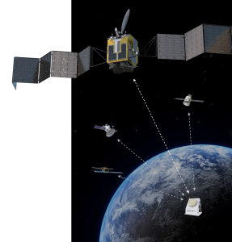
Identifying Your Market – page 3
Quasar Satellite Technologies were awarded the Tech23 Greatest Potential Award for 2021 (https://tech23.com.au/2021/quasar/). Tech23 brings together the Australian innovation ecosystem to celebrate young companies creating great things with deep tech. To get to this stage demands hard work, strategic planning, effective communication and a clear understanding of your market.
5. What is the problem or challenge the team at Quasar Satellite Technologies are looking to solve?
Imagine you are a partner in Quasar in the early stages of establishing the business. You believe you have an idea which could lead to a ground-breaking product, a ground-based station which will have the capability of communicating with hundreds of satellites simultaneously.
6. What might the open questions, probing questions, and closed questions have looked like when Ilana and the Quasar team were investigating the viability of their idea during conversations with existing ground station owners and managers?
Start-up businesses like Quasar satellite Technologies are crucial to the economy. In a CSIRO media release¹ compiled by Simon Hanson, Director SME Connect. The article identifies Small and Medium Enterprises (SMEs) as Australia’s largest employer. Contributing more than half of Australia’s GDP (57%) and making up 99.8% of all business.
7. In monetary terms what is the estimated value of SMEs to the Australian economy in 2021 (assuming the figure above has remained unchanged since 2021)?
¹ https://www.csiro.au/en/news/news-releases/2022/small-and-medium-businesses-key-to-driving-growth-in-australia

Slide 4
Identifying Your Market – page 4
In a review of the Australian Space Industry provided to the Department of Industry, Innovation and Science by ACIL Allen Consulting, the authors of the review concluded that an estimate of $3 billion to $4 billion in revenue and around 10 000 full time equivalent staff (FTE)² was a reasonable estimate for the size of the space industry in 2015. With the establishment of the Australian Space Agency in 2018 the government set the agency goals to triple revenue to $12 billion and create a further 20 000 jobs by 2030.
8. Using the information below develop an infographic which compares the Australian Space Industry around the year 2015 and the industry in 2020.
NOTE Values and figures listed are estimates and approximations based on information from several online sources.
2015 | 2020
Global share 0.8% | Global share 1.2%
Revenue $3 bn-$4 bn | Revenue $5.7 bn
FTE staff 10 000 | FTE staff 15 200
Number of companies 388 | Number of companies 829
14 satellites in orbit | 28 satellites in orbit
² https://www.industry.gov.au/sites/default/files/2019-03/australian_space_industry_capability_-_a_review.pdf
SPACE CAREERS WAYFINDER IS A COLLABORATION BETWEEN
THE CSIRO AND THE AUSTRALIAN NATIONAL UNIVERSITY

