Slide 1
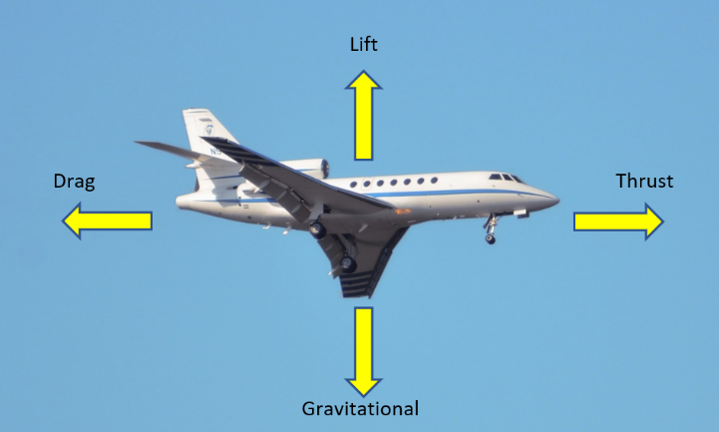
Space Careers Wayfinder Iterative Design Process
Background
The Iterative process can be applied to many different situations. Common in business and professional roles, iteration or repeating a process until the goal is achieved is also used in everyday life. A relatively straightforward task such as preparing and cooking a meal can be an iterative process. Suitable ingredients have to be selected and added to the dish in the correct quantities. Appropriate cooking times and temperatures used to produce the desired result, and maybe even a few tweaks to the ingredients to give a more personalised dish.
In Luke’s video he talks about the design process he first learned at school and how he still uses the iterative design process in his role as a manufacturing supervisor at Gilmour Space Technologies. By following the key stages manufacturers and in some cases service providers can be reasonably confident their product is fit for purpose before they invest in full scale production.
The iterative design process involves the following:
Identify a challenge or need
Brainstorm ideas and variables
Design a prototype
Test
Modify, redesign and retest
Repeat the previous step to determine the best outcome from combining different ideas
Aerodynamics is study of how objects move through air. It includes how the air moves around the object and can help explain the flight of an aeroplane through an atmosphere.
Both the iterative design process and the study of aerodynamics can be investigated by using the humble paper plane. Unlike the childhood efforts of building the most basic paper planes that often have random flights, intentional modifications can be made to the plane, enabling more specific goals.

Slide 2
Iterative Design Process – page 2
See 2021 world record holder, John Collins’ detailed video https://www.youtube.com/watch?v=3KqjRPV9_PY John explains the aerodynamics of paper planes and the science behind a number of plane designs. Students might incorporate some of the science into their own investigation.
https://www.youtube.com/watch?v=lVQYAdqHjcc
Longest Paper Airplane Throw Ever - Guinness World Records 2022
The world record set in 2022 for the indoor greatest distance thrown was more than one and a half times longer than an Olympic pool at just over 77 metres. This video gives an idea of how far it flew in an indoor space. It is not so open in the sharing of their ‘secret’ knowledge paper folds.
There are multiple other videos available on YouTube, the following videos give tips on throwing and adjusting paper planes to modify their flight.
https://www.youtube.com/watch?v=YOaYSCm4YcY
https://www.youtube.com/watch?v=pC7cRqVmXXo
The Task
In this activity we have listed five possible options for the teacher to choose from:
Longest flight time
Greatest glide distance
Most accurate landing closest to an open marker spot
Most accurate landing closest to a marker spot around an obstacle
Through two hula hoops that are not collinear. E.g., Second hoop at a slightly higher or lower location but in the same horizontal direction. Alternatively, at a different horizontal angle.
The selected option may be dependent upon the type of indoor open area available for the session.
NOTE – the activity can be done outdoors on a calm day, but prevailing conditions will affect student results.
Considerations:
Option 4 – Place the marker inside the maximum throwing distance with the obstacle in the direct path to the marker, somewhere between the launch position and the marker. To qualify the plane must pass around the obstacle, not under or over the obstacle.
Option 5 – If using the height difference option, the students will investigate the elevator flap changes, whereas the rudder flap option is needed to change horizontal direction. An advanced option would involve both flaps to be adjusted for a height and horizontal directional change.
Equipment
A4 paper – recycled if available.
Ruler
Long tape measure (20 – 50 m) and/or ball of string with every metre marked out with some electrical tape and number written in permanent marker for each metre.
1m ruler
Mobile phone (if permissible) for photos of flap angle modifications and then to video flights and outcomes.
Safety glasses

Slide 3
Iterative Design Process – page 3
Other variables for modifications
Several types (gsm) of paper.
Additional extras such as paper clips or sticky tape and their exact locations.
Any other materials that the teacher or students can easily source that is cheap and does not present an extra risk, such as breaking into sharp pieces.
Once the plane is built, use the videos to see how the following three variables can be altered. These are crucial for all full-sized airplane designs.
Wing angle from vertical centre line (dihedral angle)
Rudder angles
Elevator angles
Watch https://www.youtube.com/watch?v=YOaYSCm4YcY especially from two minutes, 25 seconds onwards for how to adjust each of these variables.
Bear in mind, small adjustments can cause noticeable change, so no need to make wildly exaggerated bends in surfaces. It is the modifications, retesting and application of new-found knowledge that will bring about the best final designs. It is important to record the changes and the outcomes of each individual change, so that ideas regarding combined changes can be designed and tested.
To gain an element of consistency, the groups should devise a way so that the launching force is constant. Hint – What physical limitations could be used to have a consistent release length for the hand to move before releasing the plane? Additionally, students can practise throwing a small ball of crumpled paper to land close to the same spot every time. Then use this same force for launching every flight. They can practise a few times before each flight to maintain consistency.
Research task
Draw what is meant by positive and negative dihedral angle. Use an ‘end-on’ angle of view. Which one is better for flight?
What things may happen if the plane is not symmetrical?
The following two questions refer to wing control surfaces.
If a plane is curving to the left, describe with aid of a diagram what you could do to straighten the flight path.
If a plane nose dips too much toward the ground, describe with aid of a diagram what you could do to give it extra lift.
The following relate to careers in the space and allied industries.
Brainstorm potential trades that go into making rockets/ satellites. Think of existing trade skills and newer ones like 3D printing and composite materials.
Use the website (https://www.gspace.com/) to find three career options that may interest you in future. Write a paragraph description of the career and include why you may be interested in the role. Bear in mind there are manufacturing, engineering and ‘other roles’ available.
Define the following types of jobs – fitter, turner, fabricator, aviator, electrical/propulsion and avionics engineers.
Look at TAFE site for your state or territory and speak with your career’s advisor. Identify five courses that can be useful for space industry.
SPACE CAREERS WAYFINDER IS A COLLABORATION BETWEEN THE CSIRO AND THE AUSTRALIAN NATIONAL UNIVERSITY

