Slide 1
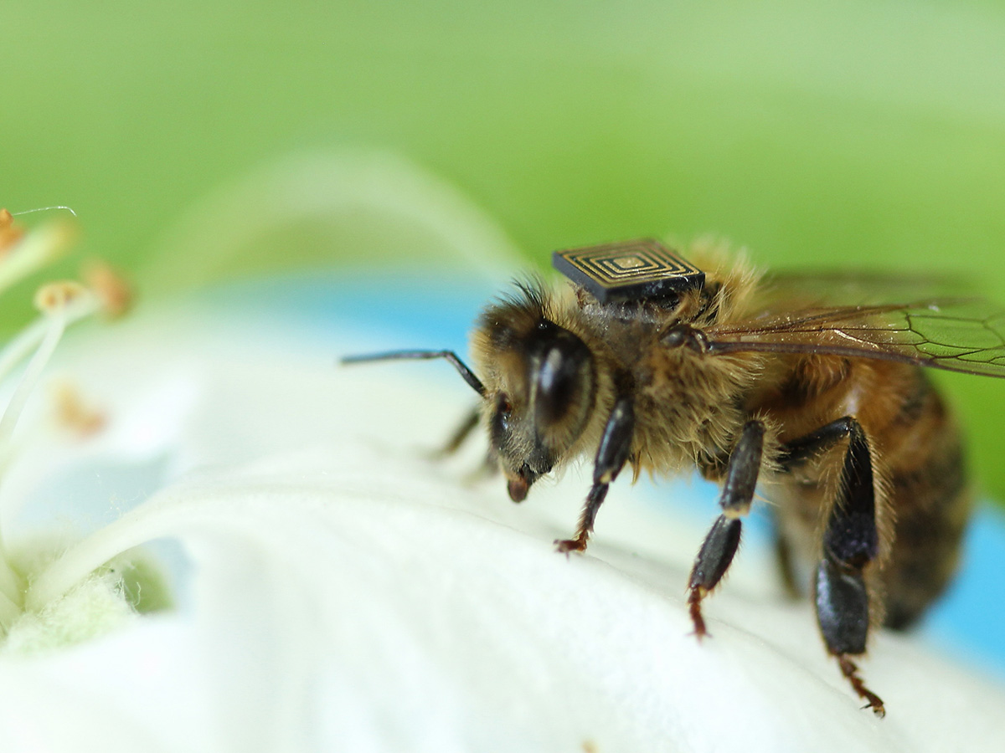

Innovate. Improve. Grow.
BEE FITTED WITH MICRO-SENSING TECHNOLOGY.
Notes:
Bee fitted with tiny sensor to collect data that will provide valuable insights into bee behaviour and inform the development of sustainable long term solutions for bee health.

Slide 2
About CSIRO
The Commonwealth Scientific and Industrial Research Organisation (CSIRO) has delivered solutions for the environment, business and society for over 100 years.
Top 1%
of global research agencies
5000+
talented staff
1800+
Australia’s largest patent holder
Annual benefits from CSIRO research
>$6 Billion
Research portfolio provides estimated return >5:1
50+ research centres across Australia, Chile, France and USA
3000
industry partners across 80+ countries
$1 Billion research organisation
Notes:
Capabilities
For over 100 years, the Commonwealth Scientific and Industrial Research Organisation (CSIRO) has delivered solutions for the environment, business and society.
Access world-leading R&D capability
ranked in the top 1 per cent globally in 15 of 22 research fields.
Employ an expert in your business and access world leading R&D by accessing 5000+ talented staff
Harness technology and innovation, CSIRO is Australia’s largest patent holder with over patents
Enter new markets through diversification and expansion
Access Australia’s best R&D infrastructure with over 50-plus centres in Australia and internationally, and the experts to run them.
Place a researcher into your organisation to help overcome technical challenges, streamline production and develop innovative solutions.
The value of CSIRO
Independent consulting firm, ACIL Allen Consulting, recently conducted an assessment on the value and impact of CSIRO with some pleasing results.
Extrapolating across all of CSIRO, total annual benefits from CSIRO’s research would exceed $6 billion. This suggests that the full CSIRO research portfolio is providing an estimated return of over 5:1.
“CSIRO have considered how CSIRO’s structure and operations creates a culture within the organisation which enhances the likelihood of serendipitous discovery and innovation occurring. CSIRO suggest that CSIRO’s ability to catalyse innovation is perhaps the greatest source of value that CSIRO provides to the Australian economy.”- ACIL Allen Consulting
Staff # as at 3 March 2016 = 5319
2014–15 budget = $1.2 billion
--------------------

Slide 3
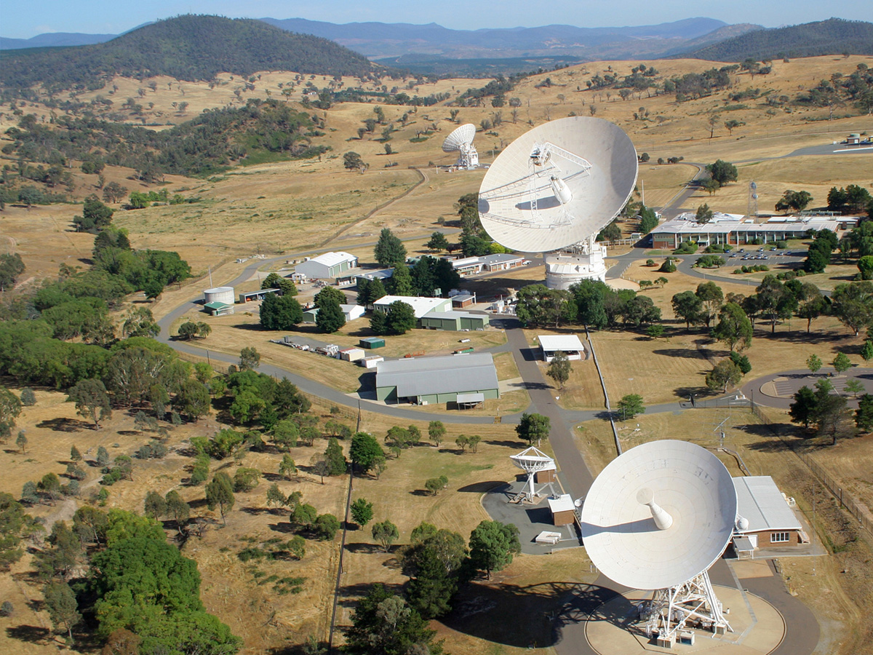
CSIRO’s role
CSIRO uses applied science and research to solve problems and make a difference to the economy, society and the environment.
CSIRO also manages important research infrastructure like the Canberra Deep Space Communication Complex (pictured), the Marine Research Vessel (RV Investigator) and the Pawsey Supercomputing Centre.
THE CANBERRA DEEP SPACE COMMUNICATION COMPLEX MANAGED BY CSIRO
IS ONE OF NASA’S THREE DEEP SPACE NETWORK STATIONS AROUND THE WORLD.

Slide 4
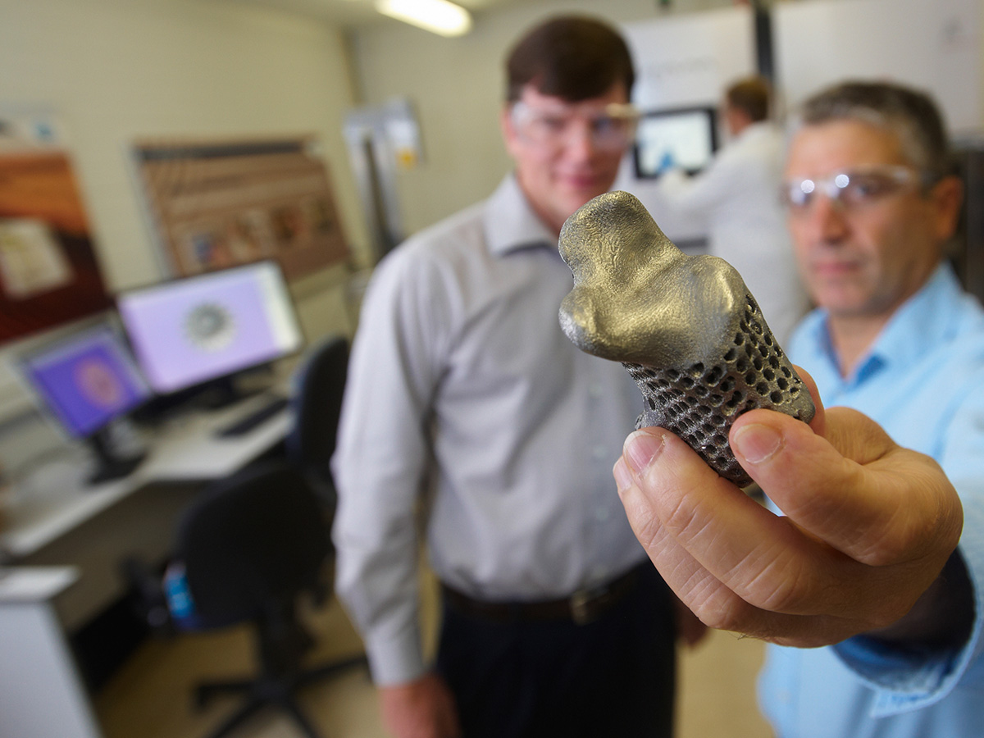







CSIRO’s focus areas
  Agriculture and Food
  Data, Digital and Cyber Security
  Energy
  Health and Biosecurity
  Land and Water
  Manufacturing
  Mineral Resources
  Oceans and Atmosphere
  Astronomy and Space Science
  Research Infrastructure
  Research Collections
  Education
3D PRINTED BONES FOR CANCER PATIENTS

Slide 5
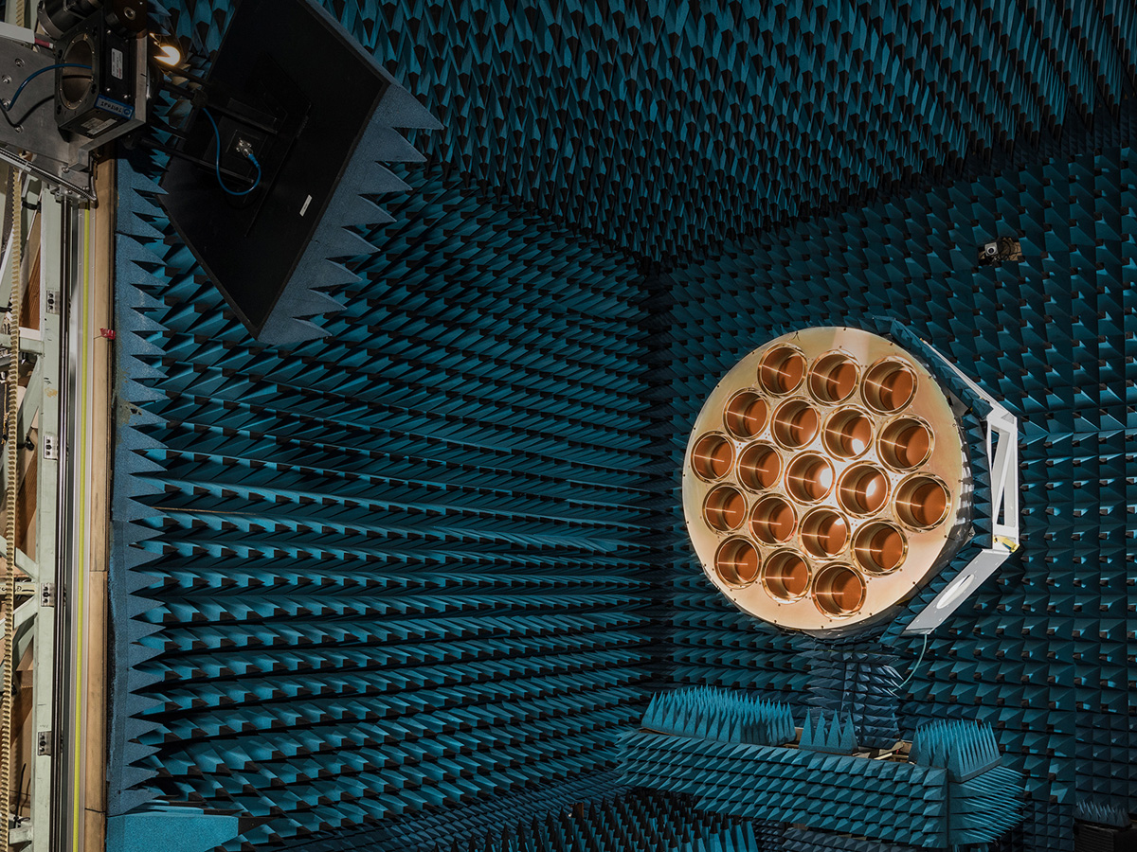
CSIRO does the extraordinary everyday
  FAST WLAN
  making WiFi possible
  Polymer banknotes
  Relenza flu treatment
  Total Wellbeing Diet
  Equivac® HeV Vaccine
  for Hendra virus
  Softly washing liquid
  Self twisting yarn
  Extended wear
  contact lenses
  Barleymax™
  high-fibre wholegrain
  Raft polymerisation
  Aerogard
  Novacq™ prawn feed
THE CSIRO-BUILT RECEIVER FOR CHINA’S FAST RADIO TELESCOPE IN CSIRO'S ANECHOIC CHAMBER, SYDNEY – THE SAME FACILITY FAST WIFI WAS INVENTED.
Notes:
CSIRO’s ability to achieve results is shown by the quality of it’s research. CSIRO’s work has changed the modern world.
Below is a snapshot of inventions:
invented the world’s best wireless technology for our homes and offices
invented plastic (polymer) banknotes which are now exported to 25 countries with more than 3 billion notes currently in circulation
developed self-twisting yarn and made children's clothing safer than anywhere in the world
invented contact lenses that can be worn for a month at a time
developed Softly washing liquid – the first formula to successfully wash wool at high temperatures, killing bacteria while not shrinking the wool
CSIRO developed Barleymax a high fibre wholegrain, which has four times the resistant starch and twice the dietary fibre of regular grains
CSIRO invented Relenza, a treatment for flu
CSIRO kept flies off her majesty, Queen Elizabeth II by creating Aerogard
CSIRO invented Equivac HeV Vaccine for Hendra virus to protect Australian horse owners and the equine industry
Novacq prawn feed – need words

Slide 6









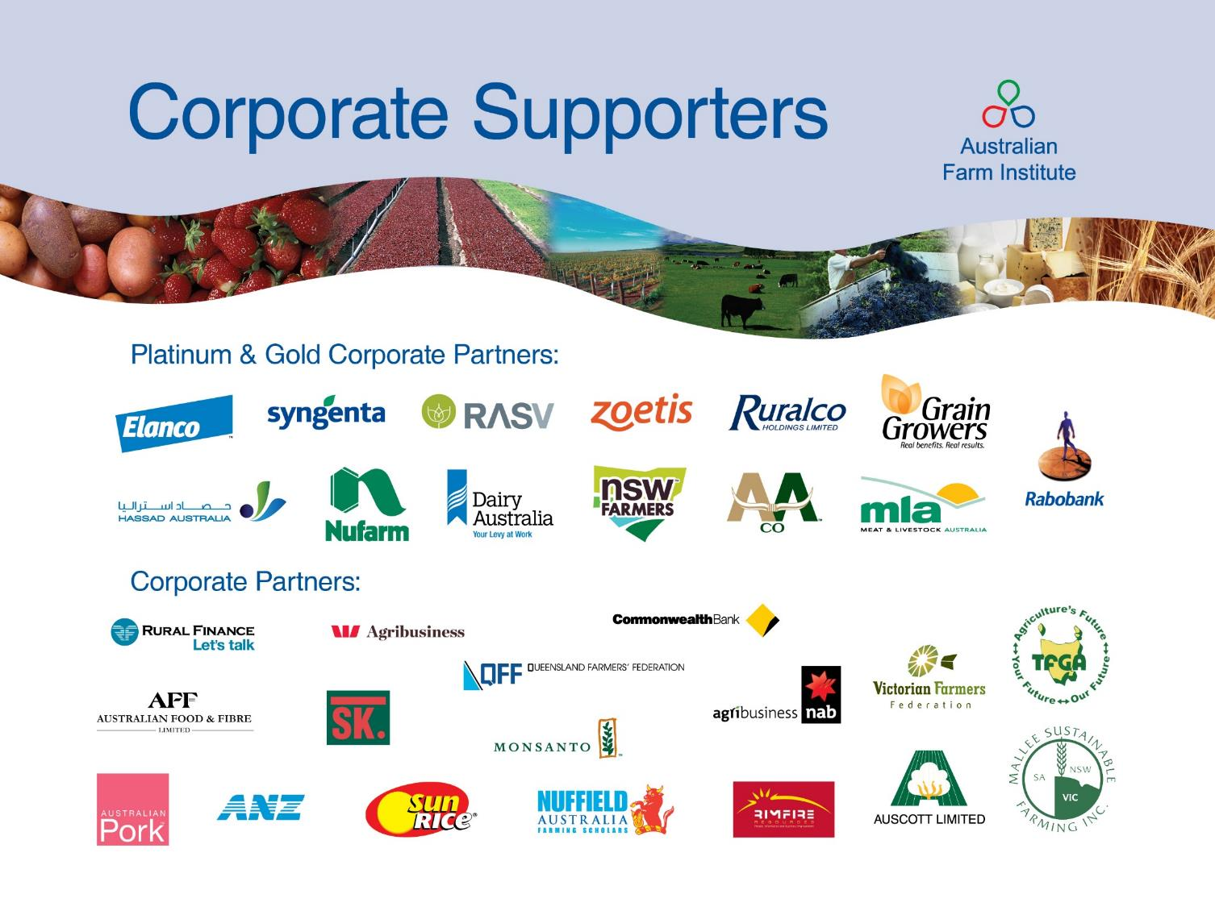













CSIRO collaborates to innovate
Notes:
CSIRO encourages strong international connections and work with partners in over 80 countries.
CSIRO works with:
Foreign governments
Small to large companies
Multi-nationals
International foundations
Leading scientific institutions
Worldwide CSIRO is involved in over 700 current or recently completed research activities.
CSIRO is a part of the Global Research Alliance to target the United Nations’ Millennium Development Goals in water, energy, health, transport, and the digital divide.

Slide 7
Doing business with CSIRO
CSIRO works with partners from around Australia and the world.
CSIRO works with research agencies, universities, small and medium companies, multi-national companies and governments.
Collaborative or contract research projects
Technology
licensing
Incubation of
high tech start‑ups
Equity
transactions
Open access
facilities
Linkage to supply chains via global partners
Researcher
placements
Additional
assistance for SMEs
Government procurement to stimulate industry

Slide 8
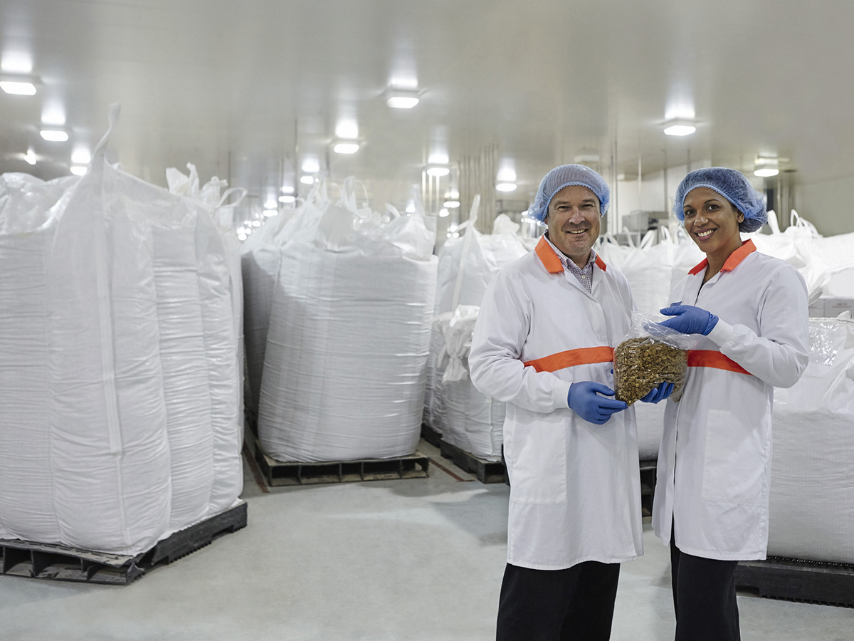
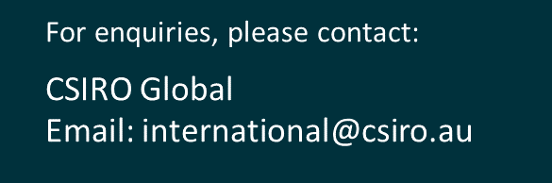
Together CSIRO can help you innovate, improve and grow.
POPINA USES BARLEYmax™ FOR A RANGE OF PRODUCTS INCLUDING CEREAL AND BARS IN THEIR GOODNESS SUPERFOODS RANGE.

