Slide 1


Innovate.
Improve.
Grow.
WEAVER: HEXAPOD ROBOT WITH 5DOF LIMBS FOR NAVIGATING ON UNSTRUCTURED TERRAIN.

Slide 2
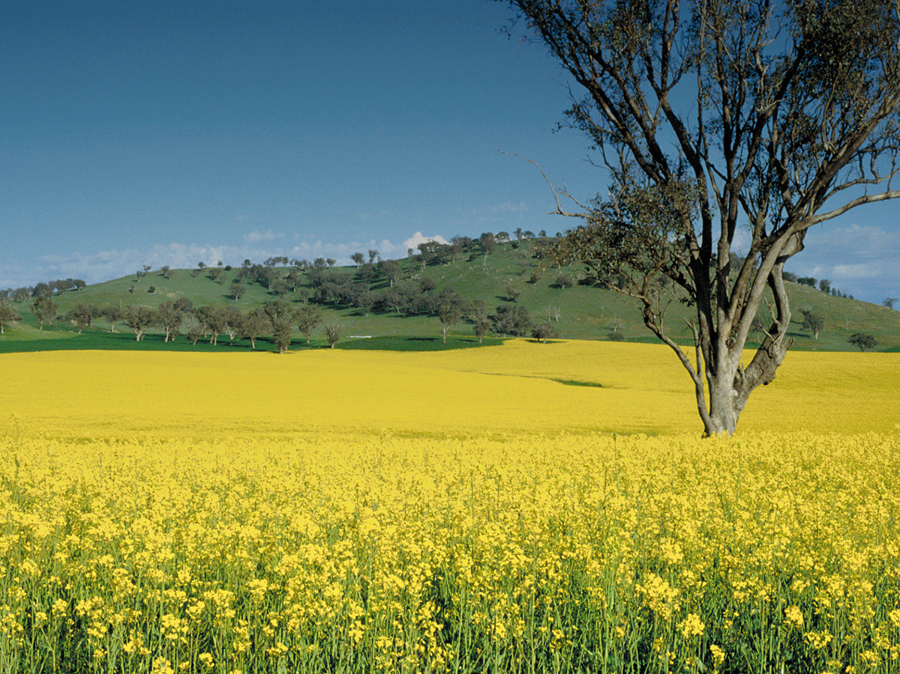
Agriculture and Food
Since it was first formed, the CSIRO has sought to understand and improve Australia's farming conditions to address the challenges of harsh soils, unrelenting droughts and low rainfall.
Over the last 100 years CSIRO has worked with Australian farmers and industry to improve productivity, profitability and sustainability, and continue to look for solutions to feeding a growing population.

Slide 3
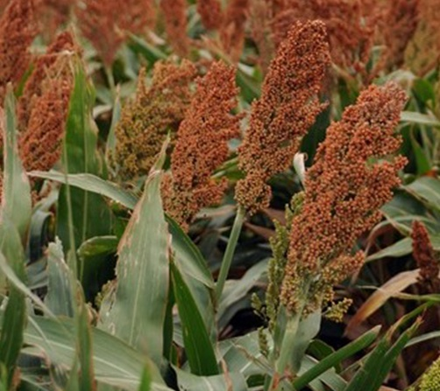

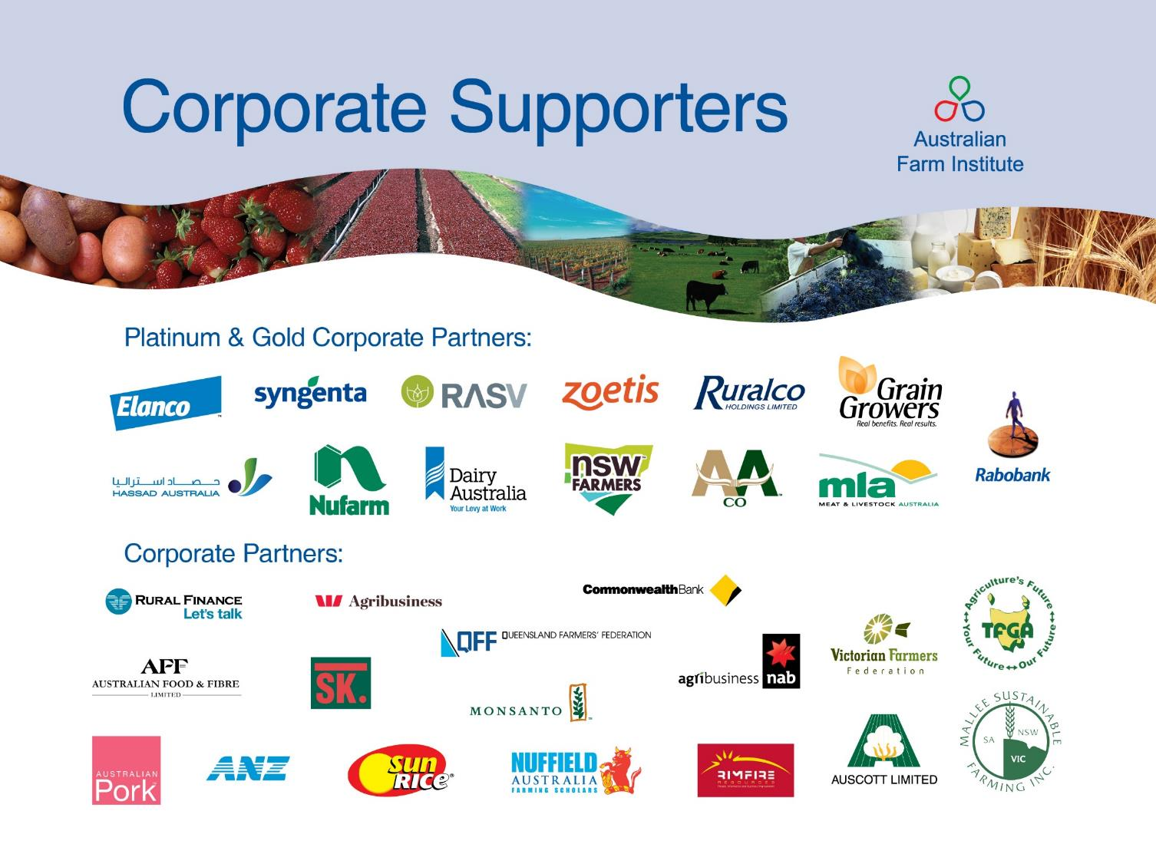



CSIRO’s capabilities
CSIRO Agriculture
research is cited
in the
top 1%
of publications
CSIRO makes a significant contribution to Australian research, and its research is of a high standard internationally.
CSIRO produces
19%
of Australia’s output in agricultural sciences
500+ partners and collaborators including:

Slide 4
Research focus areas
INPUTS
PRODUCTION
PROCESSING
DISTRIBUTION
AND MARKETING
CUSTOMER
CSIRO is at the forefront of innovation, providing solutions for cropping, livestock production, aquaculture, horticulture and the food industry.
Breakthrough genetic technologies
Breeding higher value food crops
Crop improvement for novel plant products
Productive and adaptive livestock systems
Integrated agricultural systems
Sustainable aquaculture production
Sustaining agricultural soil and landscape
Agriculture and global change
Food manufacturing and processing

Slide 5
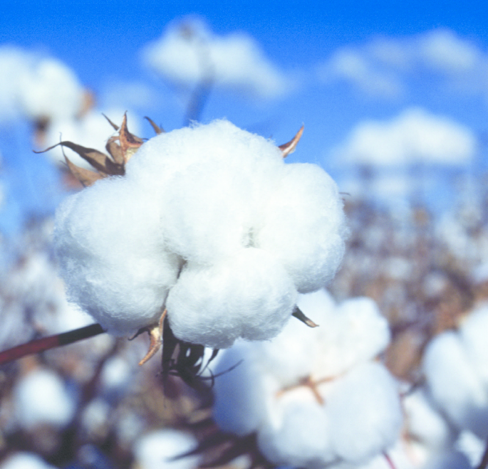
CASE STUDY
Transforming the cotton industry
THE CHALLENGE
Australian farmers need pest and disease resistant cotton varieties bred for Australian conditions.
HOW CSIRO WORKED WITH CLIENT
CSIRO worked with Monsanto using its expertise in molecular biology and plant breeding to introduce insect resistant traits into our cotton varieties.
SOLUTION
This research revolutionised disease and pest resistance, yield and fibre quality. The result was top quality cotton that is highly sought after in the global market.
Today all Australian cotton, half the dryland cotton in the United States and about one-third of the cotton in Brazil, Turkey and Greece benefits from CSIRO-bred varieties.

Slide 6
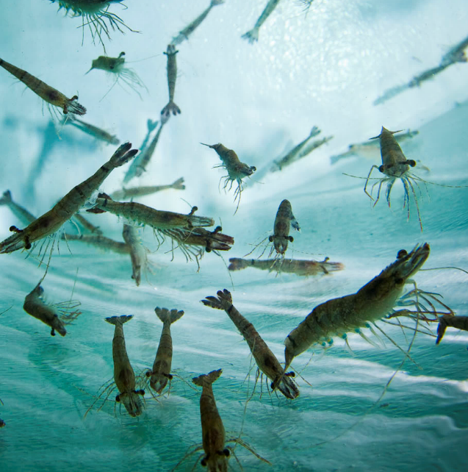
CASE STUDY
NovacqTM prawn feed – increasing productivity
THE CHALLENGE
Prawn farmers needed a solution to increase productivity while reducing reliance on wild fish stocks.
CSIRO RESPONSE
CSIRO developed an entirely natural food source produced by marine microbes.
THE RESULTS
Prawns fed with Novacq™ grow on average
20-30 per cent faster and are healthier. The production of Novacq™ commenced under licence in Australia, China and Vietnam, and since early 2017 – the rest of the world.
CSIRO’s prawn breeding and prawn breed research is expected to deliver net benefits, in terms of increased productivity of prawn production, equal to $882.8 million over the period 2004/5 to 2023/24.

Slide 7
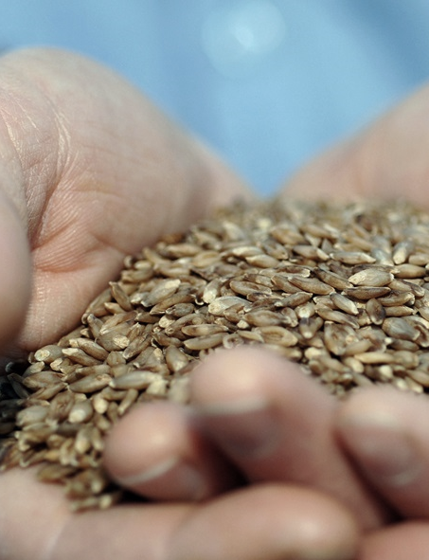
CASE STUDY
BARLEYmax™
THE CHALLENGE
Increased wholegrain intake, including barley, has been shown to reduce the risk of certain cancers, heart disease, diabetes, stroke and even help with weight control.
CSIRO RESPONSE
CSIRO developed BARLEYmax™, a wholegrain with superior health benefits that help combat cardiovascular disease, Type 2 diabetes and colorectal cancer.
THE RESULTS
A joint venture with Australian Capital Ventures Ltd saw CSIRO breed the new BARLEYmax™ grain and work with food manufacturers to create products containing it, including breakfast cereals, food wraps, rice mixes and bread. Consumers have enjoyed the benefits of BARLEYmax™ since August 2009. BARLEYmax™ is now licensed to a CSIRO spin-off company, The Healthy Grain.

Slide 8
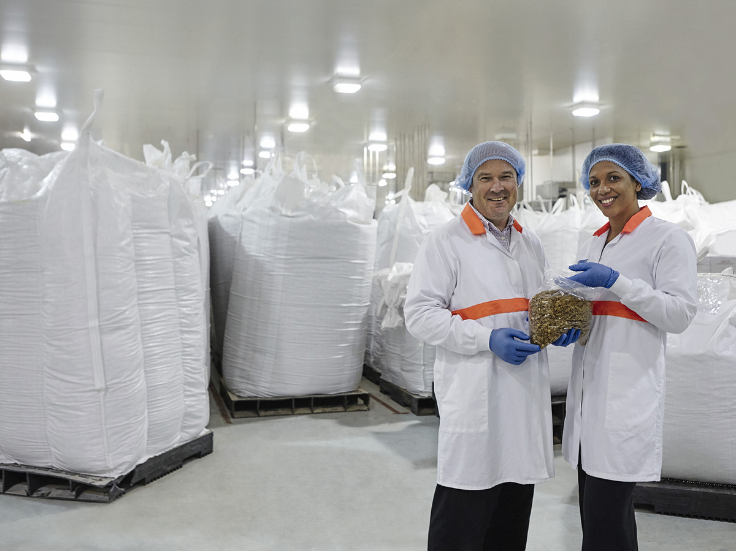
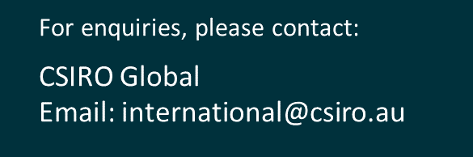
Together CSIRO can help you innovate, improve and grow.
POPINA USES BARLEYmax™ FOR A RANGE OF PRODUCTS INCLUDING CEREAL AND BARS IN THEIR GOODNESS SUPERFOODS RANGE.

