Slide 1
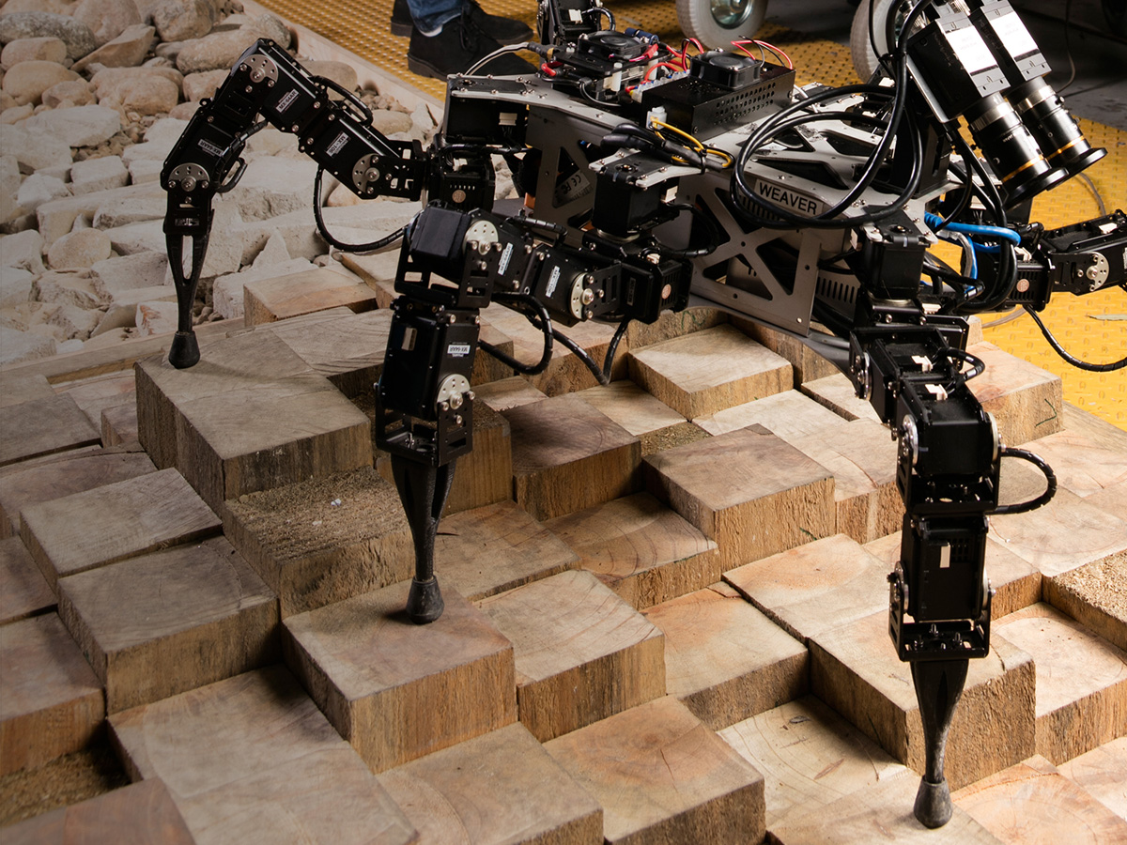

Innovate.
Improve.
Grow.
WEAVER: HEXAPOD ROBOT WITH 5DOF LIMBS FOR NAVIGATING ON UNSTRUCTURED TERRAIN.

Slide 2
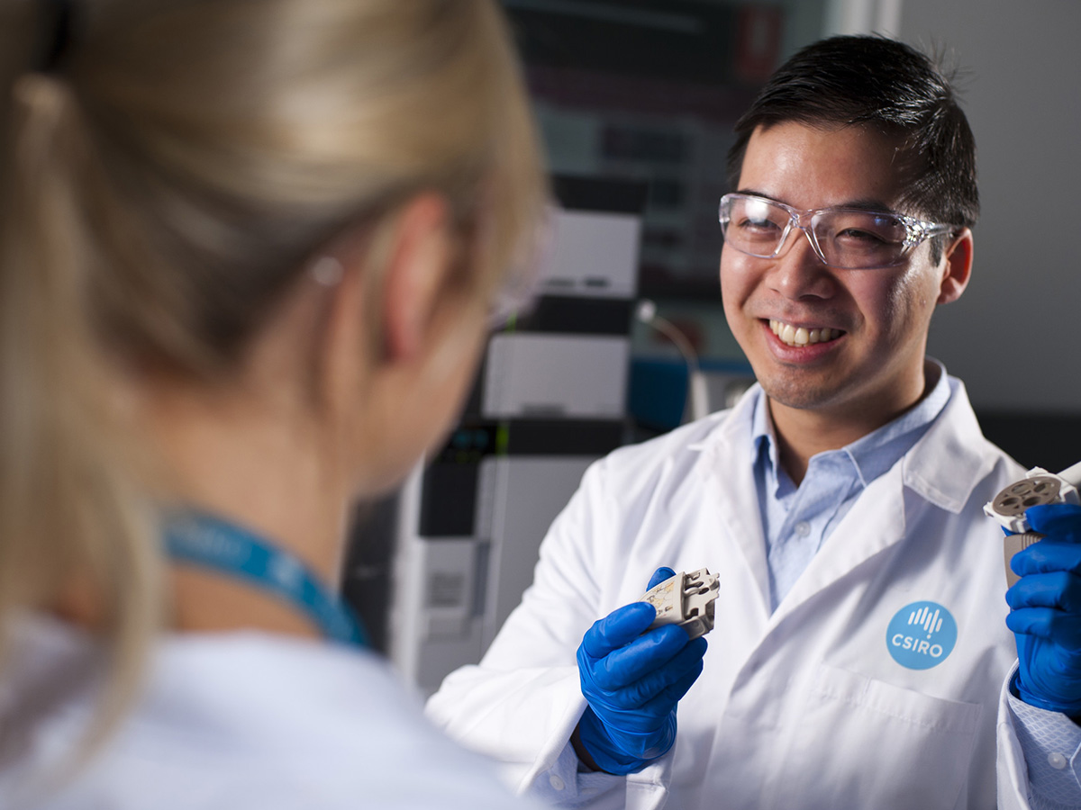
Health and Biosecurity
CSIRO conducts scientific research and develops products and services to address human, animal and environmental health and biosecurity challenges.
CSIRO’s multidisciplinary capability draws upon expertise across CSIRO’s digital, manufacturing, agriculture and land and water portfolios.
Notes:
Image: Relenza flu drug treatment

Slide 3
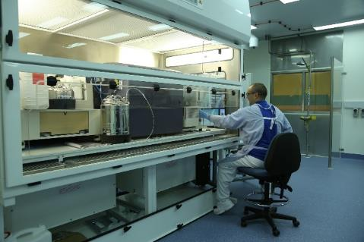
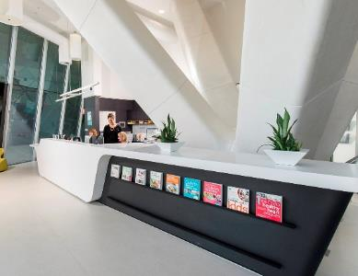
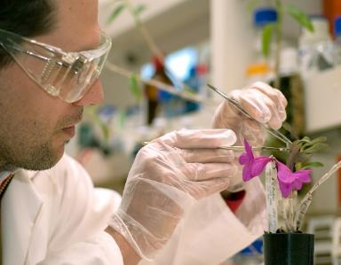
CSIRO’s key research facilities
The Australian Animal Health Facility (AAHL), VIC
AAHL is one of the largest high containment laboratories (BSL4 Zoonosis Suite) in the world. It is recognised as a centre of excellence in disease diagnosis, research and policy advice in animal health and human diseases of animal origin (zoonoses). AAHL is located in Geelong, Victoria.
South Australian Health and Medical Research Institute (SAHMRI), SA
CSIRO researchers and clinic staff work together to run a variety of human nutrition studies that lead to health impacts for the Australian community. SAHMRI is located in Adelaide, South Australia.
Tropical Plant Quarantine Facility
CSIRO has a joint CSIRO/Queensland Government Tropical Plant Quarantine Facility in Brisbane and a plant and animal quarantine facility in Canberra.

Slide 4
CSIRO’s capabilities
The Australian eHealth Research Centre –
CSIRO’s digital health research program
CSIRO partners with govern-ment, industry, science, clinical and the community to deliver science that underpins the digital revolution in healthcare.
Nutrition and health
CSIRO is delivering innovation to Australia’s food, health and wellness industries, resulting in significant health and economic benefits for Australians and the world.
Managing invasive species and diseases
CSIRO is reducing the actual and potential adverse impacts of pests, weeds, and pathogens on agricultural industries, the environment and our way of life.
Risk evaluation and preparedness
CSIRO develops non-invasive PoC biosensors, risk assessment of novel technologies and situations of high uncertainty and develop pre-event mitigation strategies to support the delivery of health and biosecurity.
Probing biosystems
CSIRO is active in the future of healthcare research in wearable and biocompatible implantable sensors for early disease detection, organ-on-a-chip technology, embedded biosensors for health outcomes, and point-of-care diagnostics.
Precision Health
CSIRO is proactively focussed on building an integrated precision health platform to manage a person’s lifetime health through decision support tools and highly tailored food, nutrition and lifestyle interventions.
Notes:
Image: AAHL

Slide 5
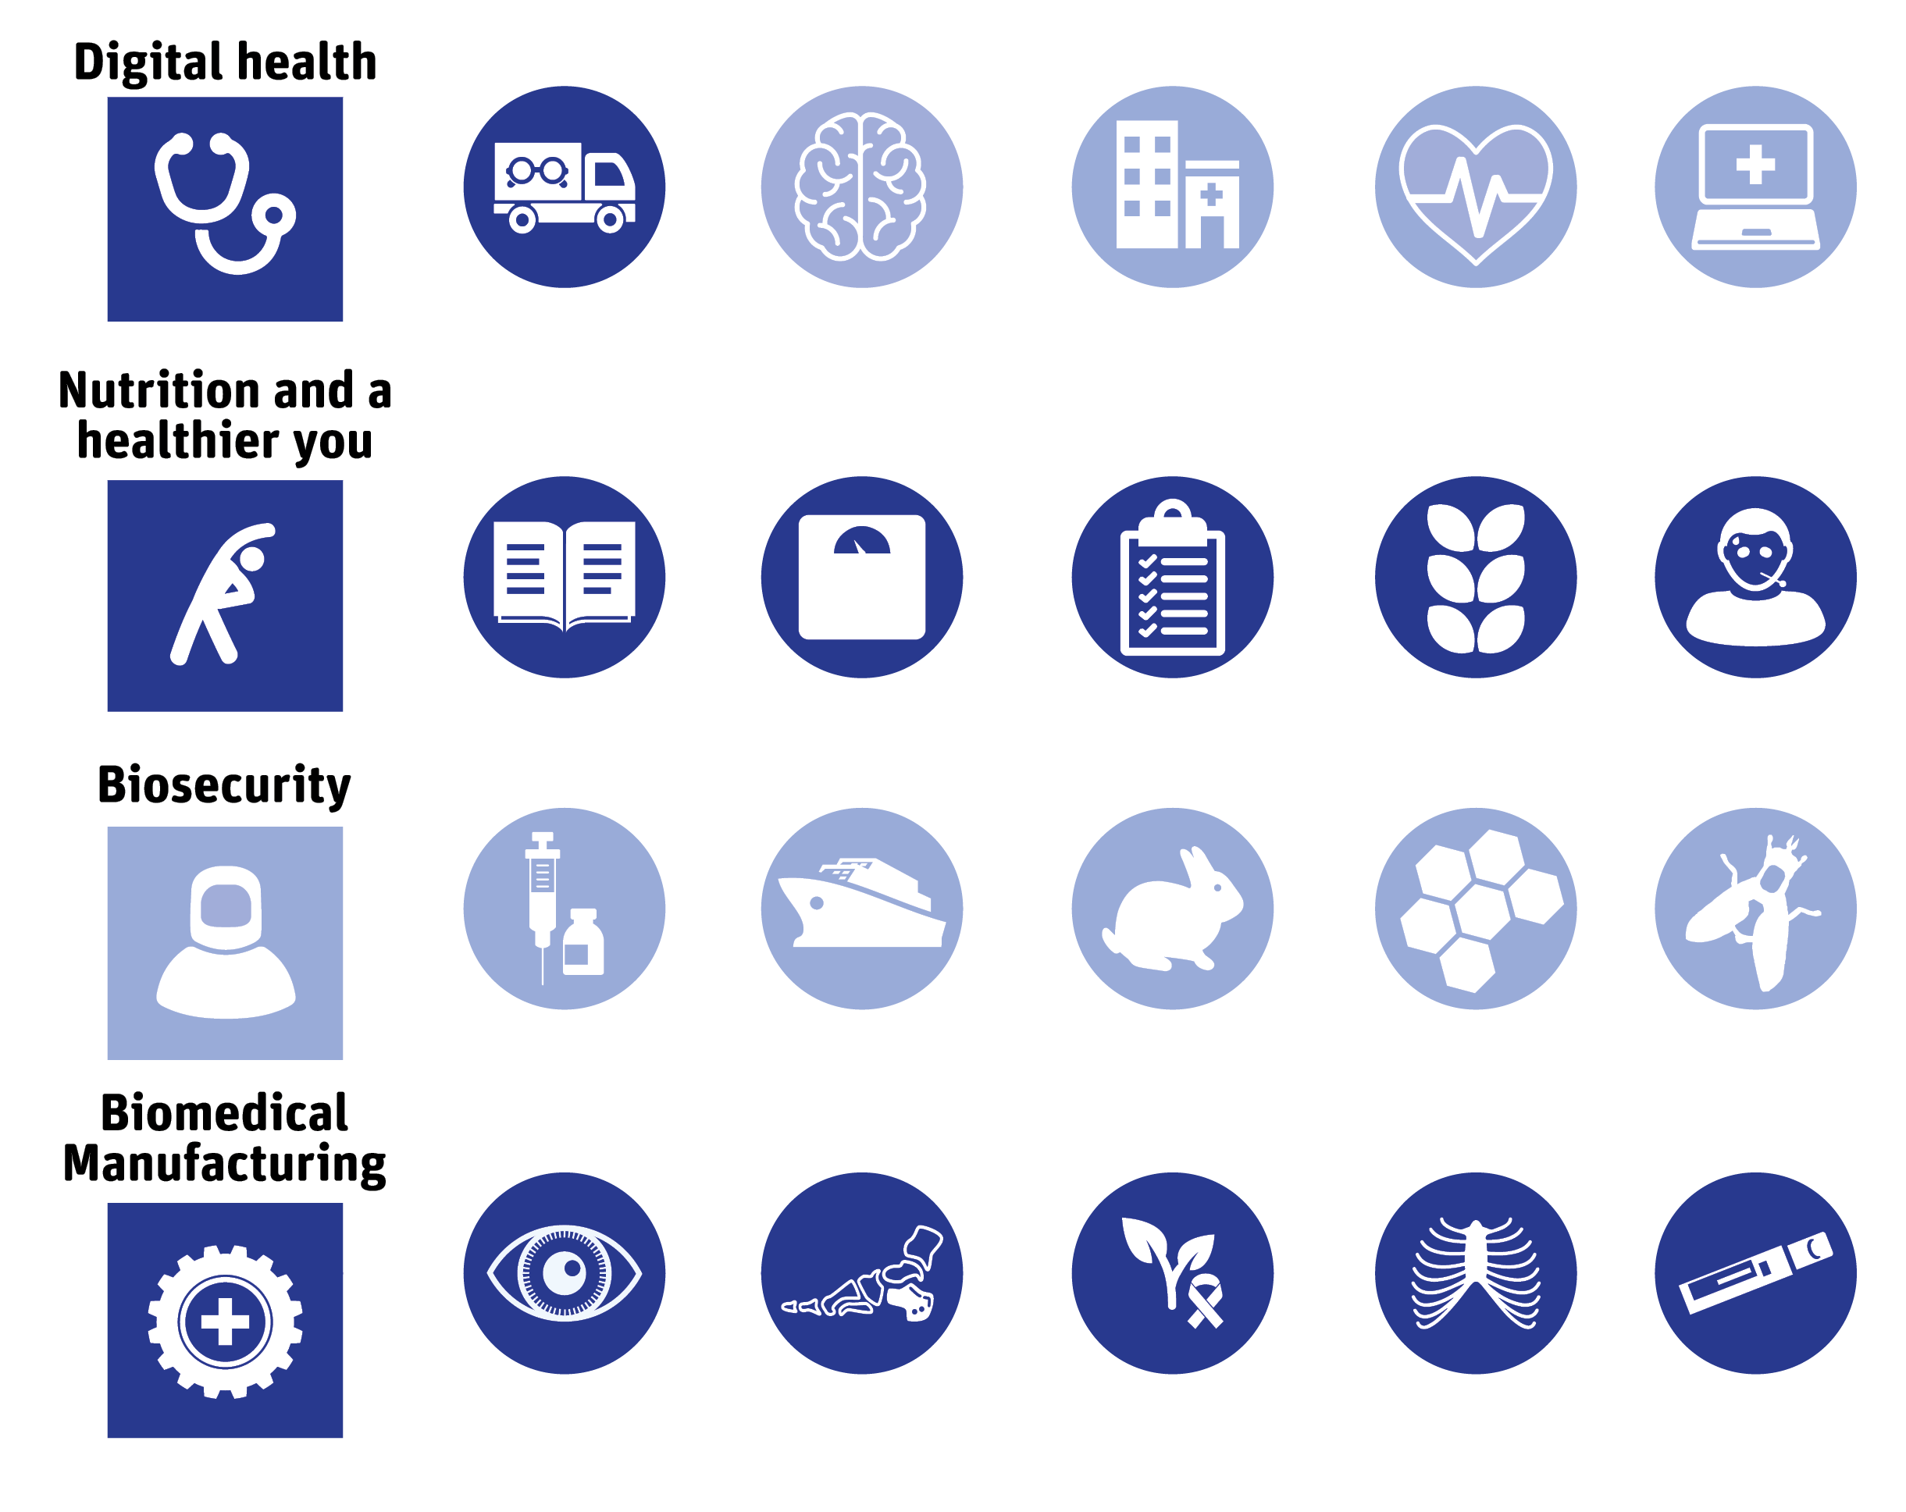
CSIRO’s contribution to health
From apps to 3D printing, global epidemics to preventative wellbeing, CSIRO's work in health makes a difference to industry, people and the planet.

Slide 6
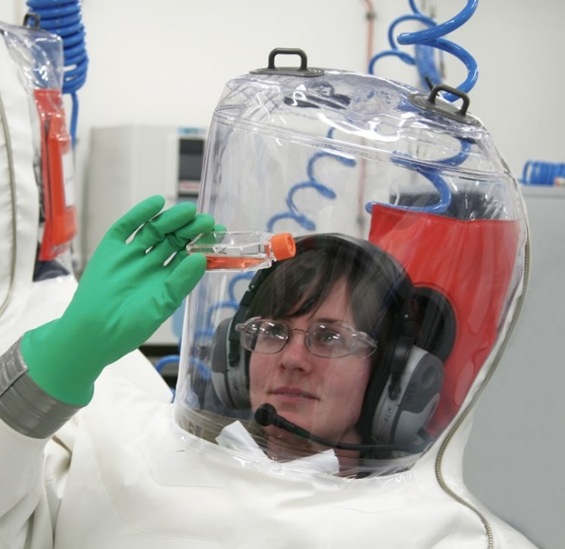
CASE STUDY
Advancing the frontline fight against the Hendra virus
The Australian Animal Health Laboratory (AAHL) is managed by CSIRO and helps protect Australia’s multi-billion dollar livestock and aquaculture industries, and the general public, from emerging infectious disease threats. It is a high-containment facility designed to allow scientific research into the most dangerous infectious agents in the world.
The Equivac® HeV is a world-first commercial vaccine for a Bio-Safety Level-4 disease agent.
The vaccine has reduced costs of future disease response and containment and minimised the chances of the Hendra virus mutating and spreading more readily between horses, or from human to human.
In 1994 AAHL's diagnostic team isolated and identified a new virus that had not been previously reported anywhere else in the world.
The Hendra virus is transmitted from animals to humans and is a Bio-Safety Level-4 disease agent, which is the most dangerous level in the world.
Notes:
https://www.csiro.au/en/About/Our-impact/Our-impact-in-action/Health/Hendra
The Equivac® HeV is a world-first commercial vaccine for a Bio-Safety Level-4 disease agent. This vaccine enables commercial and private equine activities to continue with minimal negative impact by increasing personal safety for horse owners, vets and others regularly interacting with horses. It also enhances security for the Australian horse industry and reduces time spent in quarantine.
The vaccine has reduced costs attributed to future disease response and containment and minimised the chances of the Hendra virus mutating and spreading more readily between horses, or from human to human.
The Australian Veterinary Association now recommends that all horses in Australia are vaccinated against the Hendra virus.

Slide 7

CASE STUDY
ImpromyTM Health and weight management program
CSIRO developed ImpromyTM health and weight management program in collaboration with CSIRO's partner Probiotec Ltd.
ImpromyTM is a health improvement program involving point of care testing to assess weight and risk factors such as cholesterol, blood pressure and blood glucose.
The program is delivered through pharmacies and includes meal replacements, high protein meals and provides ongoing support by trained pharmacy staff.
The Impromy™ program focuses on improving health through weight loss and good nutrition.

Slide 8
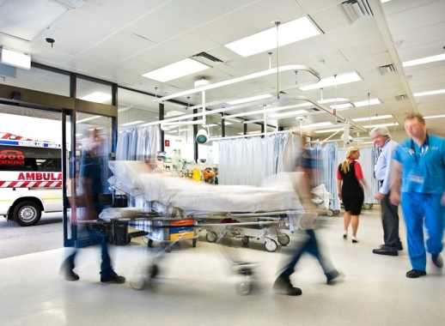
CASE STUDY
Cutting hospital waiting times
CSIRO developed software to help hospitals predict how many patients will arrive in emergency, their medical needs and how many
will be admitted or discharged.
CSIRO Australian eHealth Research Centre worked in partnership with Queensland Health, Griffith University and Queensland University of Technology to develop the Patient Admission and Prediction Tool (PAPT).
The PAPT software accurately forecasts emergency ward demand to help ensure access to care and hospital beds.
The potential value of these improved patient outcomes, once fully implemented, is A$97 million per annum across Queensland and well over A$248 million per annum Australia-wide.

Slide 9
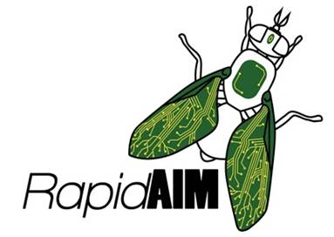
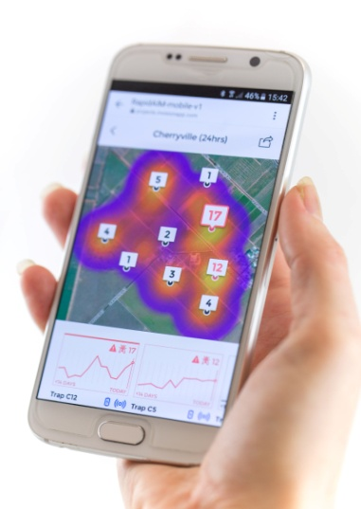
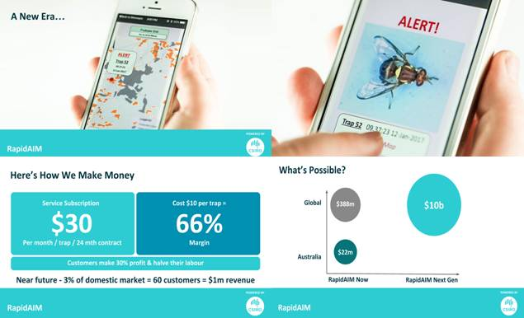
CASE STUDY
Supporting the protection and growth of crops and exports
  RapidAIM is a service platform that provides real-time detection and image notification of insect pests using wireless trapping technology.
  This immediate data-driven decision service will allow farmers and biosecurity managers to respond immediately to pest detection.
  This technology allows protection of crops and markets and is supporting the development of new trading opportunities.

Slide 10
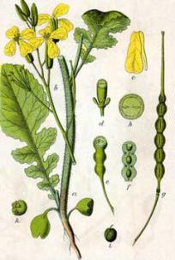
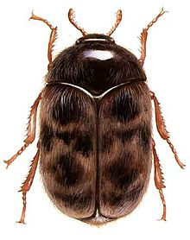
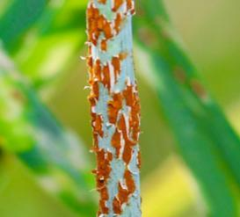
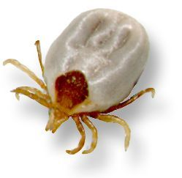
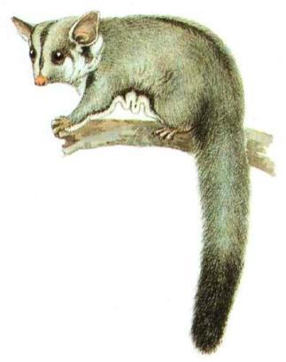
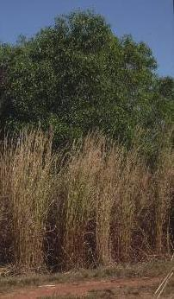
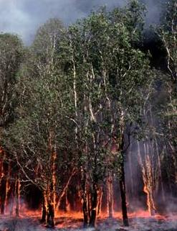
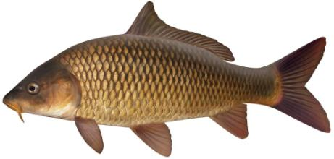
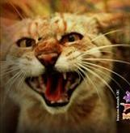
CASE STUDY
Managing invasive species impacts
Smart technologies and data processing for Eradication, Containment, Disinfestation and area freedom.
Rapid data processing - Therapeutics, Vaccines.
Monitoring and evaluation of effectiveness of Biological control systems for invasive animals and plants.
Integration systems-based approaches across government, industry & community for pest & disease management.
Agriculture
Weeds
$6B / yr*
Crop pests
$1B / yr*
Plant diseases
$1B / yr*
Animal diseases
$1B / yr*
Environment
90% of fresh water fish
22 extinct marsupials
Transformed ecosystems
*Figures are costs to the Australian agriculture industry per year

Slide 11
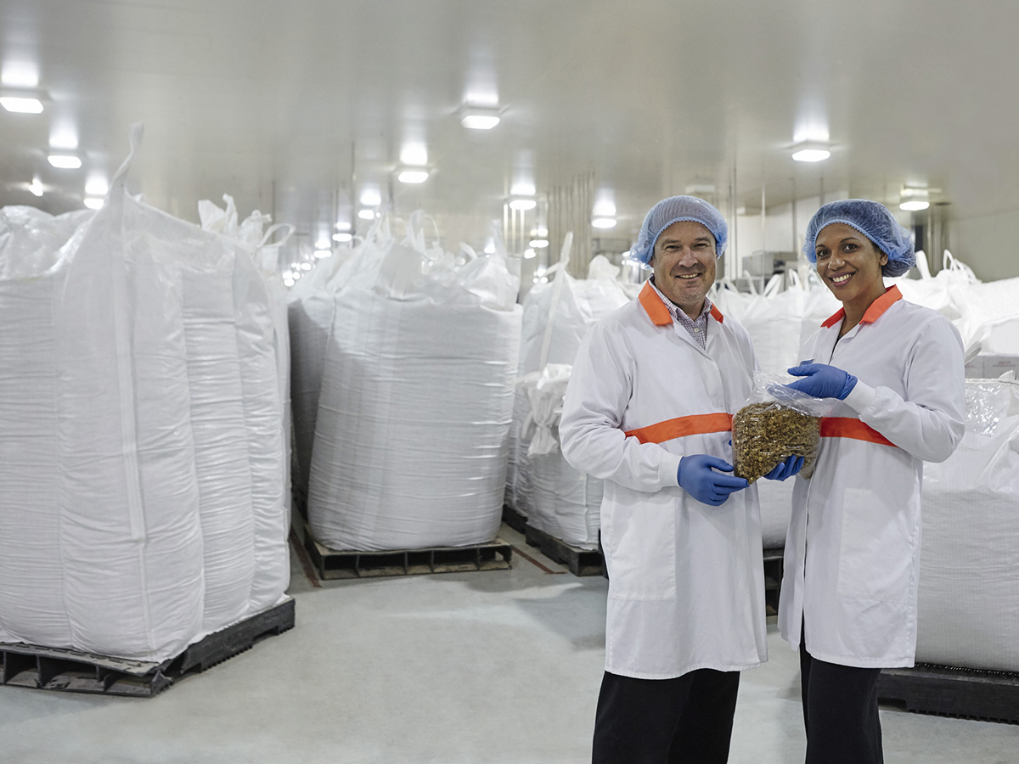
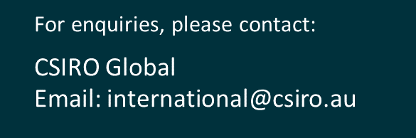
Together CSIRO can help you innovate, improve and grow.
POPINA USES BARLEYmax™ FOR A RANGE OF PRODUCTS INCLUDING CEREAL AND BARS IN THEIR GOODNESS SUPERFOODS RANGE.

