Slide 1


Innovate.
Improve.
Grow.
WEAVER: HEXAPOD ROBOT WITH 5DOF LIMBS FOR NAVIGATING ON UNSTRUCTURED TERRAIN.

Slide 2

Land and Water
CSIRO aims to deliver innovative solutions to the complex challenges that arise from the demands and impacts of human activities on the environment.
CSIRO's expertise addresses Australia's national challenges and is increasingly supporting other nations to respond to complex economic, social and environmental issues related to water, land, cities and ecosystems.
Algae patterns in waterway near Perth, WA, in the late 1980s.

Slide 3
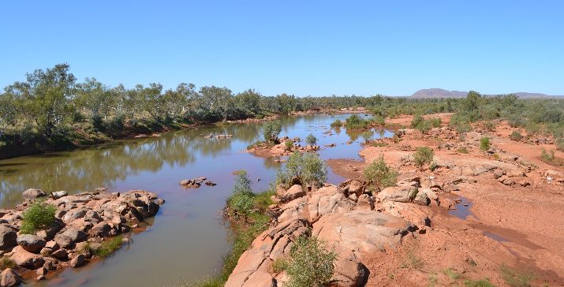
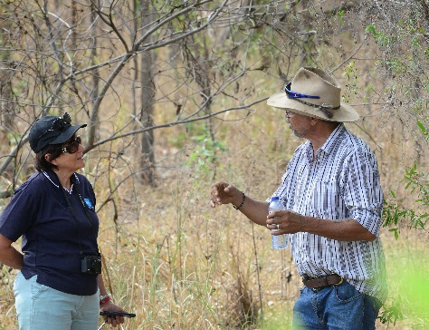

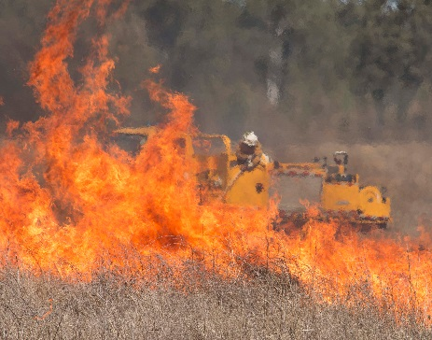
Key research capabilities
CSIRO provides the information and technologies required by government, industry and the Australian and international communities to protect, restore, and manage natural and built environments using an integrated systems research approach.
CSIRO's key capabilities include
Ecosystems and biodiversity
Mitigating environmental contaminants
Social, economic and urban systems
Measuring and managing water resources
International water research and development
Landscape management
Synthetic biology
Earth observation and informatics
Environmental testing and analytical services

Slide 4
Research focus areas
Biodiversity, ecosystem knowledge and services
Informing management of Australia’s unique and diverse ecosystems.
Water resource management
Helping Australia to better manage its river basins and groundwater resources, and to improve social, economic and environmental benefits from water resources management.
Environmental contaminant mitigation and biotechnology
Underpinning the management and protection of Australia’s land and water resources from pollution and contamination.
Adaptive urban and
social systems
Understanding the complex interaction of social, economic and environmental factors to enable more informed decision-making, planning, governance and engagement processes.
Basin management outcomes
Delivering science and technologies to improve social, environmental and economic benefits from water in developing nations.
Landscape intensification
Addressing challenges associated with the management of land for multiple uses.

Slide 5
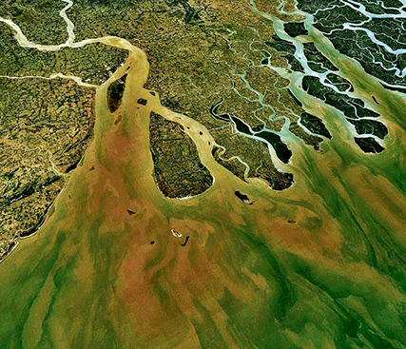
CASE STUDY
Clean water for Bangladesh
The Bangladesh Integrated Water Resources Assessment has identified key future challenges for Bangladesh in water use and management.
CSIRO is working nationally and internationally to increase access to safe water and inform policies and strategies that support effective water resource management.
CSIRO has completed the Bangladesh Integrated Water Resources Assessment which identified key future challenges and opportunities for water use and management in Bangladesh.
The Ganges delta, Bangladesh: Better management of groundwater resources will strengthen Bangladesh’s food security, which is threatened by the loss of productive land to seawater intrusion, the overuse of ground water resources from population pressure and an increase of floods and droughts due to climate change. Credit: NASA World Wind/Wikimedia Commons

Slide 6

CASE STUDY
Managing Australia’s precious water resources
CSIRO is helping Australia to maximise the value derived from its water resources. CSIRO’s research informs water planning, management and investment decisions.
Australia’s demand for water continues to rise with its growing population and the expansion of water intensive industries such as mining and agriculture.
CSIRO conducted a series of comprehensive water resources assessments in the Murray-Darling Basin, northern Australia, south-west Western Australia, and Tasmania; plus assessments in the Great Artesian Basin, and the Flinders and Gilbert River catchments.
CSIRO found water development opportunities and constraints under a range of scenarios.
CSIRO's water resource assessments provide regulators with the confidence to make sound water allocation decisions, and provide security of access against which investment can be made.

Slide 7
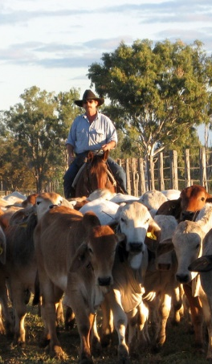
CASE STUDY
Livestock logistics
CSIRO's Transport Network Strategic Investment Tool (TraNSIT), analyses transport and logistics options for agriculture to identify potential cost savings.
Agriculture supply chains in Australia are often characterised by transport distances of over 1000 km between production, processing and markets, with transport costs accounting for up to 40 per cent of the market price.
Infrastructure investment and policy changes can reduce costs across agricultural enterprises, but it has not been possible to evaluate the whole system to ensure that infrastructure investment maximises whole of industry productivity.
CSIRO developed TraNSIT to analyse both small and large scale investments in the agriculture supply chain, with current applications covering almost all Australian agricultural logistics.

Slide 8
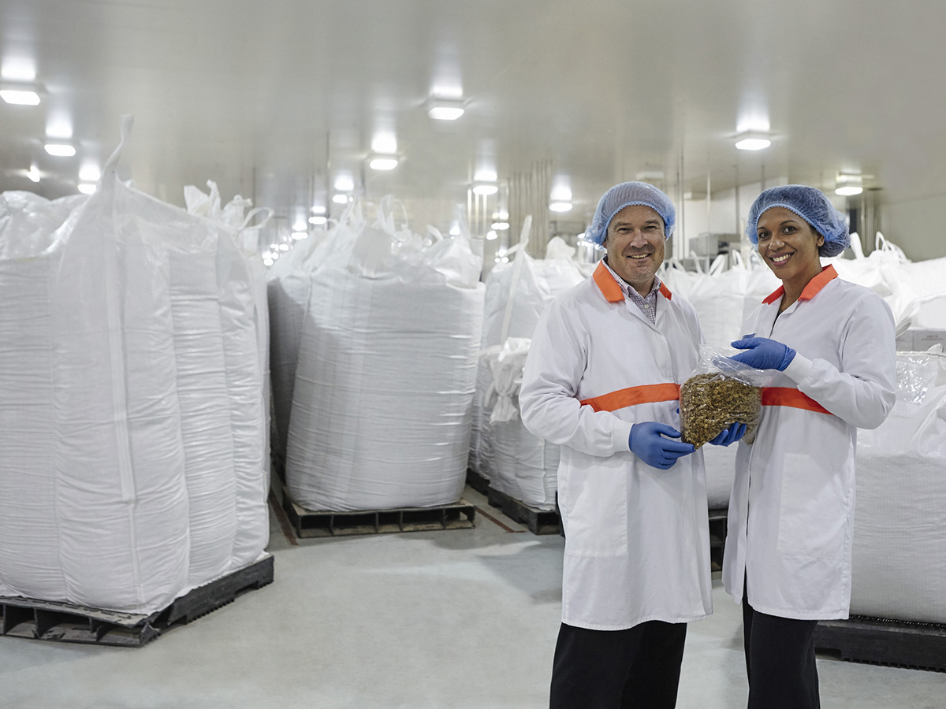
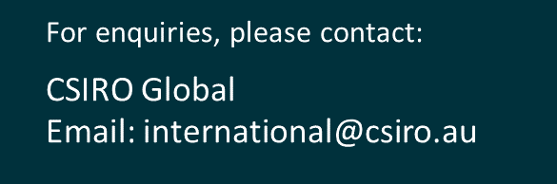
Together CSIRO can help you innovate, improve and grow.
POPINA USES BARLEYmax™ FOR A RANGE OF PRODUCTS INCLUDING CEREAL AND BARS IN THEIR GOODNESS SUPERFOODS RANGE.

