Slide 1


Innovate.
Improve.
Grow.
WEAVER: HEXAPOD ROBOT WITH 5DOF LIMBS FOR NAVIGATING ON UNSTRUCTURED TERRAIN.

Slide 2
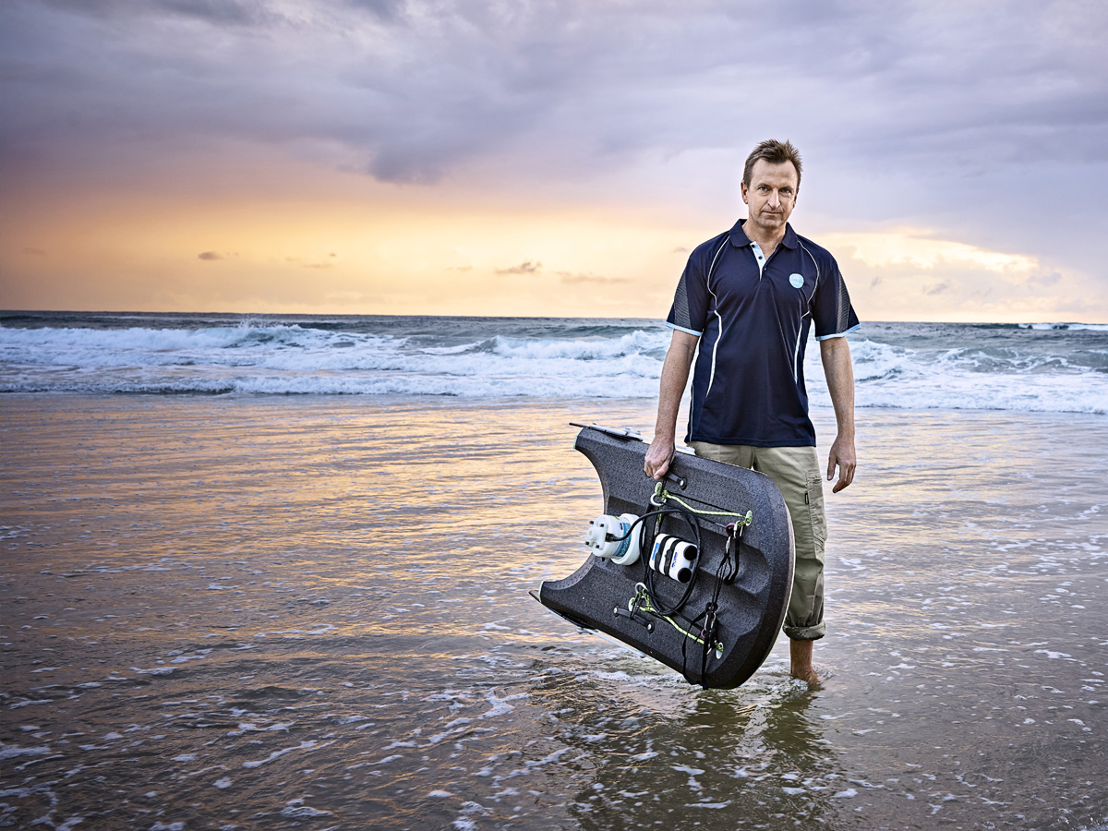
Oceans and
Atmosphere
CSIRO Oceans and Atmosphere provides knowledge to manage Australia’s marine areas and atmospheric environment. CSIRO's research deliver significant economic, social and environmental benefits for Australia and the world.

Slide 3
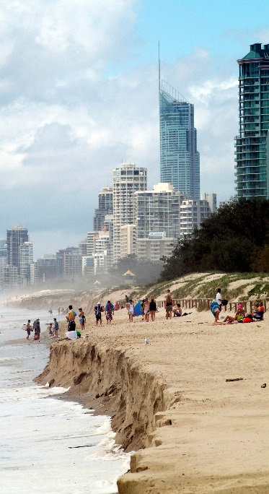
Research capabilities and programs
Marine and atmosphere protection
Short and long term climate prediction
Observational ocean and atmosphere data
Marine resource economics and management
Hydrodynamic,
biogeochemical and ecological modelling
Ocean and climate
dynamics
Oceanography across timescales from waves to climate
Air quality assessment and emissions inventory
Bio-optics,
acoustics and
eco-genomics
Technology
and
engineering
Data acquisition, analysis and management
Biogeochemical sampling and analysis
Mechanical, electronic and software engineering

Slide 4
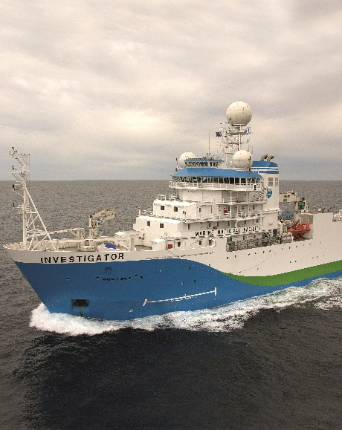
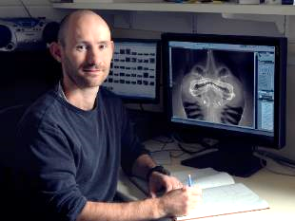
Infrastructure and facilities
Climate Science Centre
Climate modelling and observations of atmosphere and ocean
Air Pollution Station
CSIRO is a lead partner in the Cape Grim Baseline Air Pollution Station, Tasmania
Antarctic Gateway Partnership
Developing
next-generation
polar science
Indian Ocean Marine Research Centre, Perth
Largest marine research capability in the Indian Ocean Rim region
National Fish Collection
Records that track
large scale change houses over 151,000 specimens from over
3,400 species
Research Vessel Investigator
State-of-the-art marine research vessel, supporting atmospheric, oceanographic, biological and geosciences research
Oceanic Calibration Facility
Calibrates a range of oceanographic instrumentation
Earth Systems and Climate Change Hub
Provides world-class climate change science to Australia’s
decision-makers
Centre for South Hemisphere Ocean Research
Notes:
Image in the centre: CSIRO's John Pogonoski capturing data from a digital radiograph ©

Slide 5
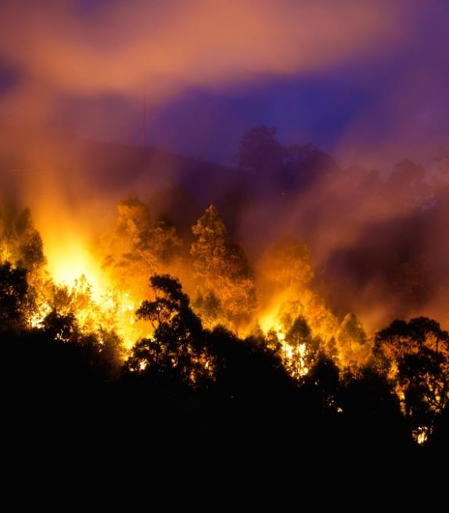
CASE STUDY
Air quality: forecasting smoke impact on health
Australia has some of the worst fire prone environments which are burned through planned and un-planned events every year.
CSIRO's air quality team have been using climate models to reduce the health risks of smoke and dust on the Australian population.
CSIRO has worked with government and university partners to develop a state-of-the-art modelling system that can simulate the burn characteristics, smoke emissions, and the smoke transport from fires.
The System was trialled during the 2015/16 southern Australia bushfire season, embedded in the operational processes of the emergency control centre, and used to provide advance warning to the community of potential smoke exposure.
The success of operational trials has led to efforts to fully operationalise the System. The model can be tailored to other regions.
The Smoke Forecasting System generates crucial information for national fire agencies to help manage planned burns, and also to provide advance warning of smoke from bush fires.

Slide 6
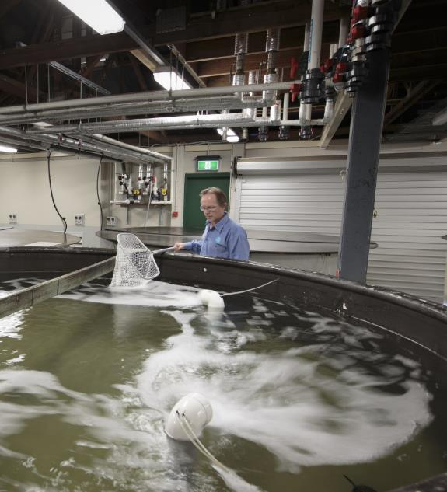
CASE STUDY
Transforming the aquaculture industry in Chile
The project aims to build the capability of industry and government to assess and manage risks within the aquaculture industry, moving towards an operational forecasting system which will prevent future catastrophes.
CSIRO’s skills in ocean colour remote sensing, whole of ecosystem, coastal and hydrodynamic modelling and marine forecasting will be used to deliver a science-based management framework tailored to the local and regional context in Chile, addressing both production and decision-making cycles and ecological dynamics of the system.
IMAGE: CSIRO Aquaculture Research Station,
Bribie Island, QLD
CSIRO is collaborating with Chilean agencies Sernapesca, Instituto de Fomento Pesquero (IFOP) and Subpesca, along with science providers and the aquaculture industry to transform and boost the Chilean aquaculture sector currently worth US$3.5 billion (Salmon 90%).
Notes:
IMAGE: CSIRO Aquaculture Research Station, Bribie Island, QLD

Slide 7
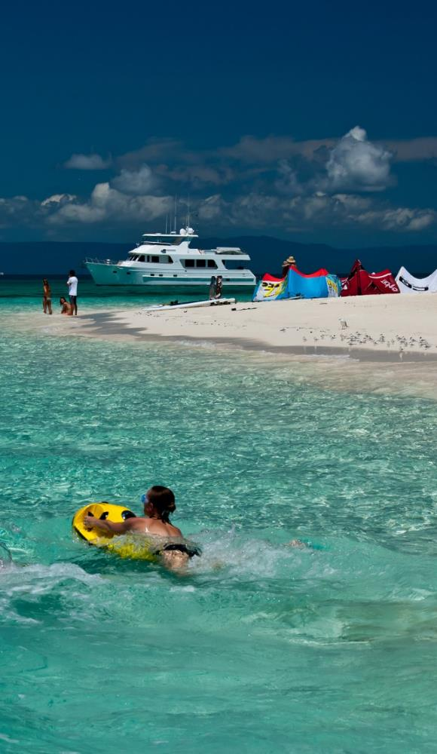
CASE STUDY
Improving management of the Great Barrier Reef
Reef systems are biologically diverse and economically valuable ecosystems, providing a range of services important to biodiversity, fisheries industries, environmental protection and tourism.
CSIRO's eReefs platform is transforming its ability to manage and protect significant reef systems, such as the Great Barrier Reef, for the long term. CSIRO has partnered with the Great Barrier Reef Foundation, the Bureau of Meteorology, the Australian Institute of Marine Science and the Queensland Government to address challenges to the reef like climate change, water quality, and impacts from coastal development.
Based on conservative assumptions, the net present value of benefits to 2025-26 from the eReefs project is $80.8 million.
Tourists with underwater scooters at Vlasoff sand cay, Great Barrier Reef. Nearly two million tourists visit the reef each year.
Notes:
IMAGE: Tourists with underwater scooters at Vlasoff sand cay, Great Barrier Reef. Nearly two million tourists visit the reef each year.
Resource ID
4099

Slide 8
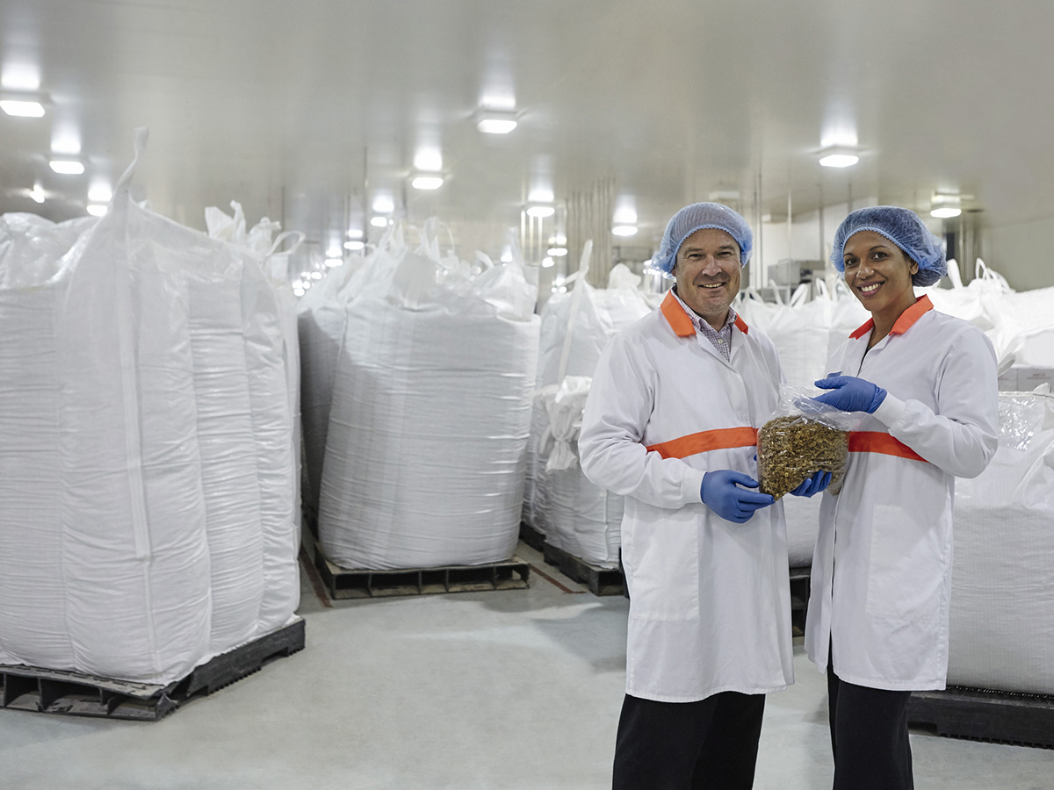
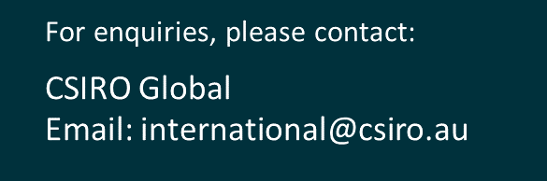
Together CSIRO can help you innovate, improve and grow.
POPINA USES BARLEYmax™ FOR A RANGE OF PRODUCTS INCLUDING CEREAL AND BARS IN THEIR GOODNESS SUPERFOODS RANGE.

