Slide 1
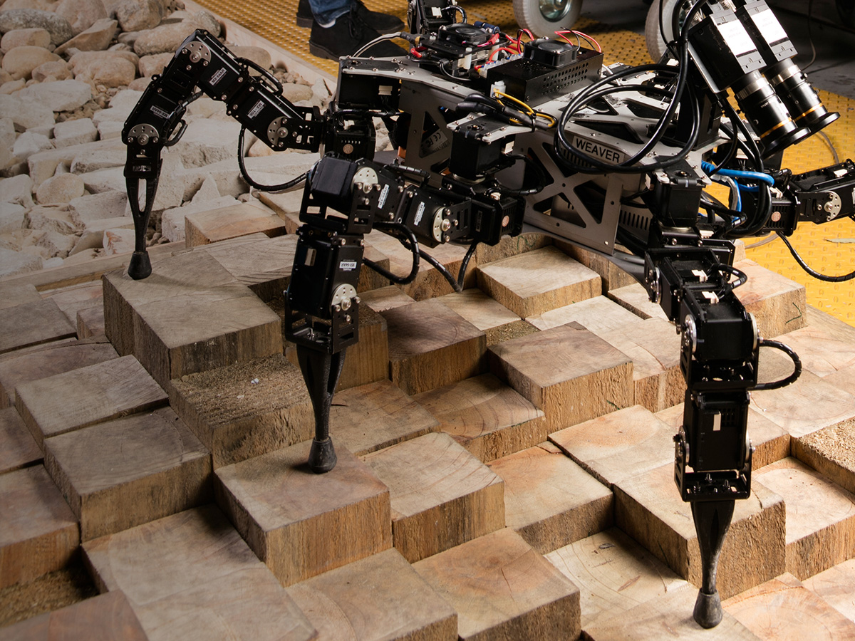

Innovate.
Improve.
Grow.
WEAVER: HEXAPOD ROBOT WITH 5DOF LIMBS FOR NAVIGATING ON UNSTRUCTURED TERRAIN.

Slide 2
Data61
CSIRO’s Data61 is Australia’s leading data innovation group.
Data61 is world leading in the domain of
data-centric R&D and the early stages of commercialising data-centric solutions.
WEAVER: HEXAPOD ROBOT WITH 5DOF LIMBS FOR NAVIGATING ON UNSTRUCTURED TERRAIN.

Slide 3
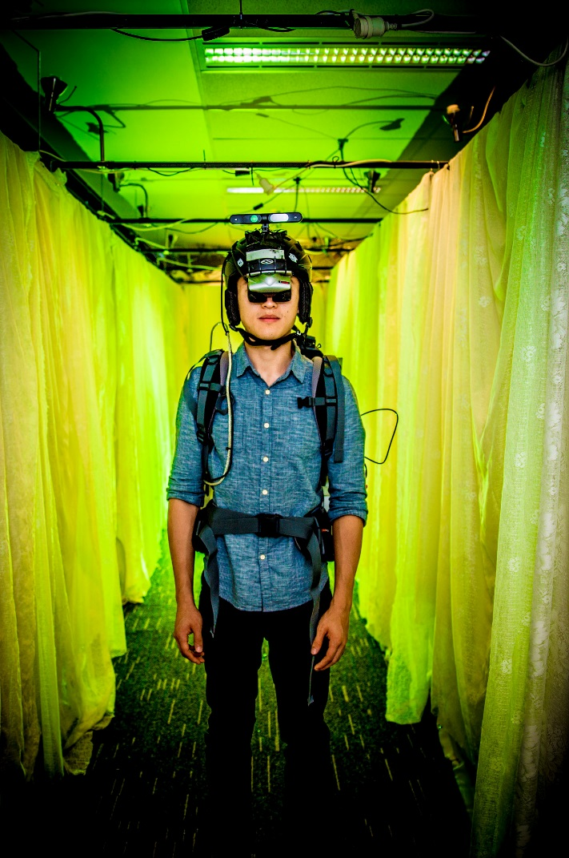
Key capabilities and technologies
Capabilities
Data capture and consumption
Communications and networking infrastructure
Hardware and software
Cybersecurity
Data statistics, modelling and analytics
Decision sciences
Behavioural economics and cognitive sciences
Technologies
Blockchain
Privacy enhancing technologies
Data accessibility/ integration
Federated and spatial data systems
Sensing and localisation
Robotics
3D SLAM
Modelling/visualisation
Deep learning
Social media analysis

Slide 4
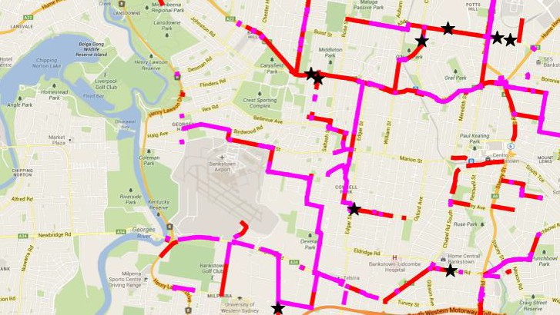
CASE STUDY
Transport and Logistics : ADAIT Platform
Data61 is building the ADAIT Platform as part of its work with Transport for NSW.
The Platform will provide a complete and holistic data reservoir to the State’s transport cluster, enabling real time decision making for congestion management.
The platform will become scalable across multi-modal transport and will be built to enable other developers to build specific purpose applications on the platform under open data frameworks.
The ADAIT Platform and the ecosystem that will surround it is potentially replicable across multiple Australian cities and exportable across the world, enabling the global move towards Smart Cities.

Slide 5
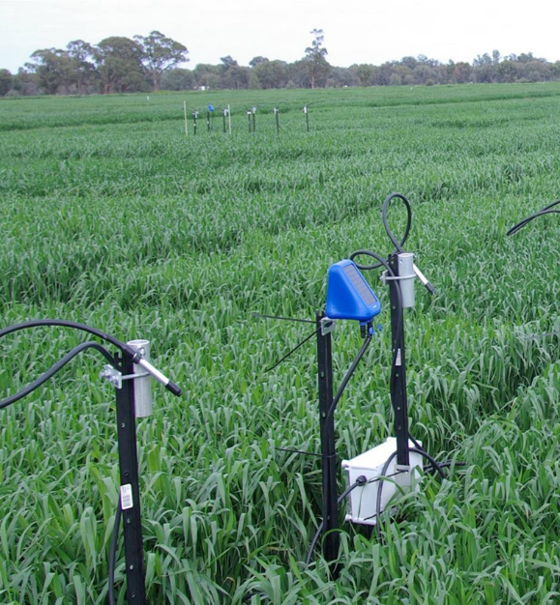
CASE STUDY
Smart Agriculture: Phenonet
Phenonet collects, processes and visualises sensor data from the field in near real-time. It is a network of wireless sensor nodes that collects information over a field of experimental crops.
The ability to collect this information from remote locations and send it back to the laboratory in real time is an invaluable tool for plant scientists.
The Phenonet system is helping plant scientists and farmers identify the best crop varieties to increase yield and efficiency of digital agriculture.
Phenonet is a world first high resolution crop selection platform. Its smart wireless sensor nodes work autonomously and independently, cooperating with each other to set up a network to record environmental conditions and wirelessly transfer data to a data store.

Slide 6
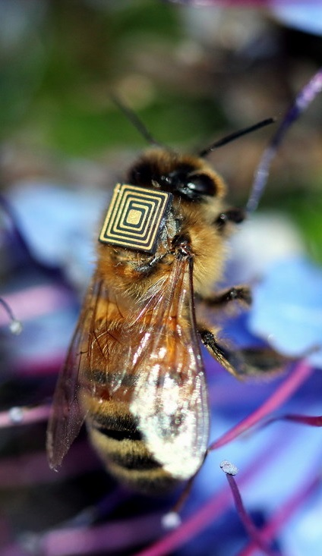
CASE STUDY
Swarm Sensing : Honey bee population monitoring
Bees are the world's most prolific pollinators of food crops, but its populations in some parts of the world are at risk from a number of interacting factors.
CSIRO’s micro-sensing technology can reveal how bees spend their time and where they travel in unprecedented detail. As part of CSIRO’s world first swarm sensing research program, CSIRO has fitted tiny micro-sensors to thousands of bees in Tasmania, in order to monitor their movements and their environment. CSIRO’s industry partners include Hitachi Chemical, who provided the micro-sensors, Intel, IMBROS and Vale.
The team is working with Brazil’s Vale Institute of Technology to take the technology to the Amazon.
Notes:
Thousands of honey bees in Australia are being fitted with tiny sensors as part of a world-first research program to monitor the insects and their environment using a technique known as 'swarm sensing'.

Slide 7
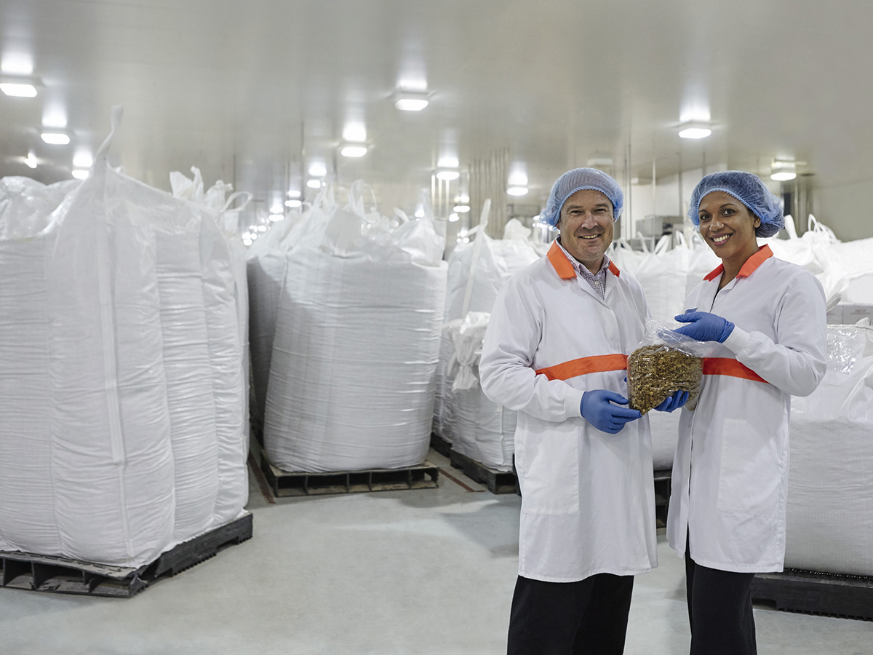
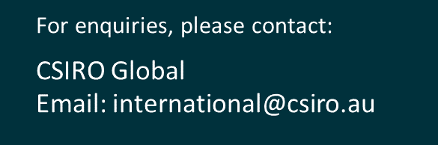
Together CSIRO can help you innovate, improve and grow.
POPINA USES BARLEYmax™ FOR A RANGE OF PRODUCTS INCLUDING CEREAL AND BARS IN THEIR GOODNESS SUPERFOODS RANGE.

