Slide 1
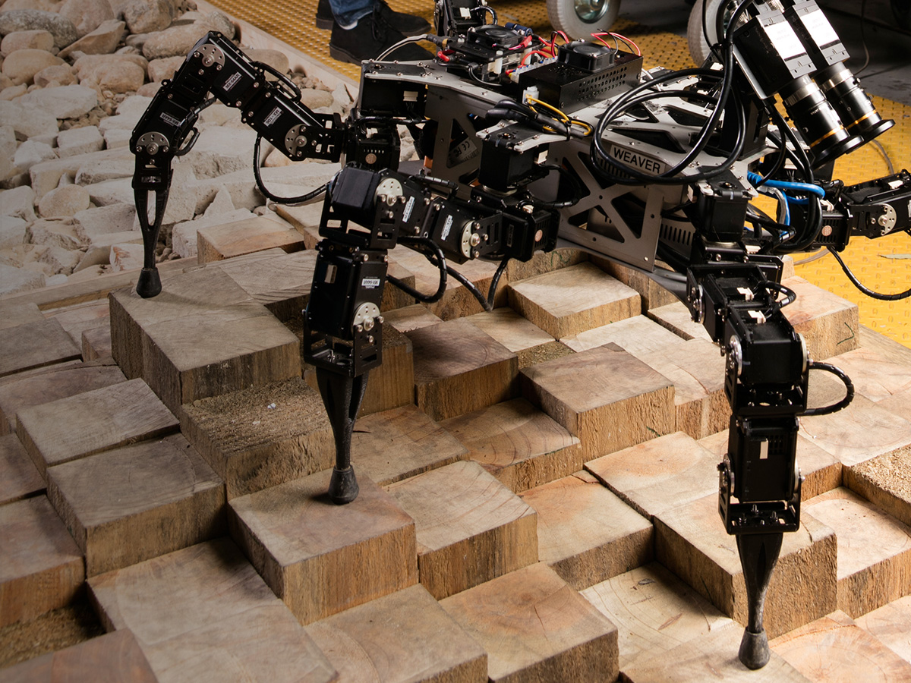

Innovate.
Improve.
Grow.
WEAVER: HEXAPOD ROBOT WITH 5DOF LIMBS FOR NAVIGATING ON UNSTRUCTURED TERRAIN.

Slide 2
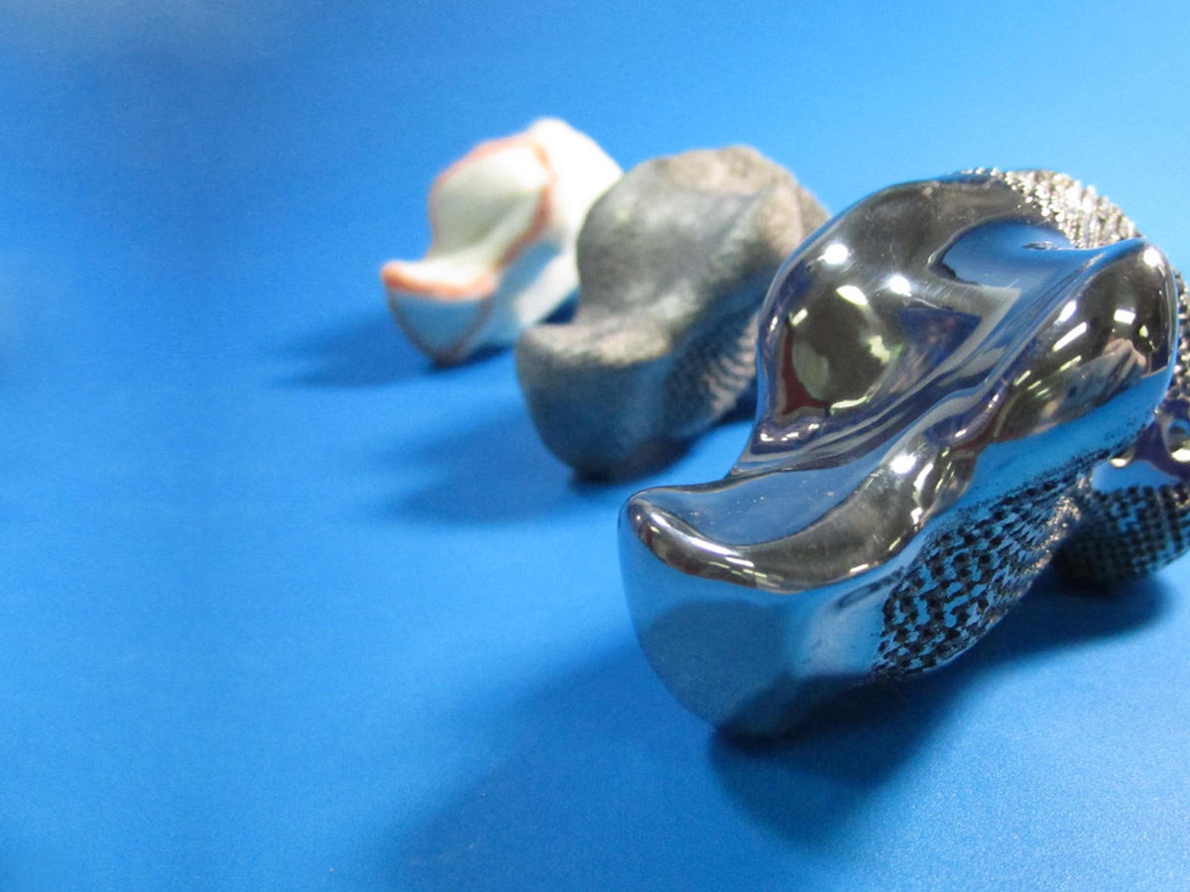
Manufacturing
Australian manufacturing is changing focus from heavy industry to high tech products based on sustainable, advanced manufacturing processes. CSIRO's science and engineering skills, equipment and international connections are helping Australian manufacturers be globally competitive.
3D PRINTED BONES FOR CANCER PATIENTS.
MANUFACTURED AT CSIRO’S STATE OF THE ART FACILITY, LAB22.

Slide 3
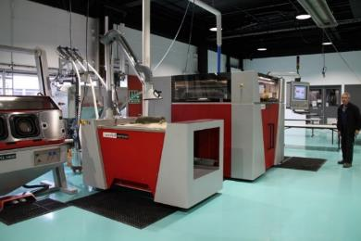
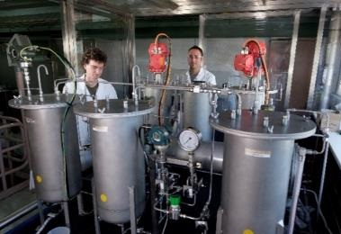
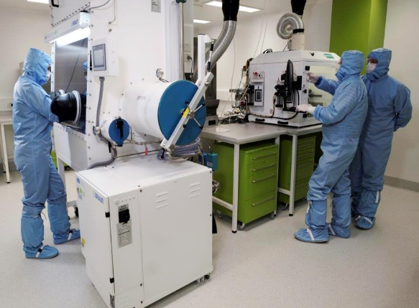
Infrastructure and facilities
Lab 22
Offers Australian companies a unique opportunity to access and explore new technologies so that they can innovate with less capital investment risk.
FloWorks
The FloWorks Centre for Industrial Flow Chemistry is a technology platform that provides access to CSIRO’s cutting edge research into industrial chemical processing for Australian and international chemical manufacturers, located in Clayton Victoria
Biomedical Materials Translational Facility
The Biomedical Materials Translational Facility (BMTF) helps medtech companies turn new discoveries into market ready products.
Carbon Fibre Facility
CSIRO is collaborating with Deakin University to develop carbon fibre technologies focused on low-cost, low-energy carbon fibre.

Slide 4
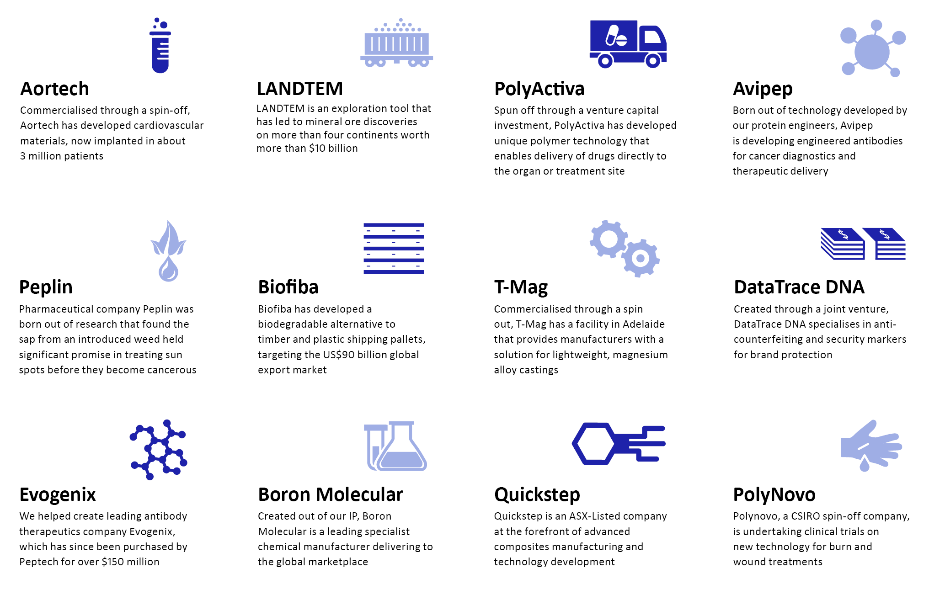
Track record

Slide 5
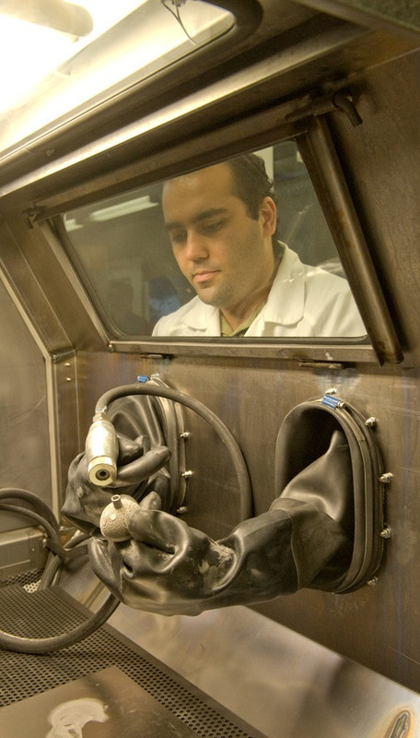
Research programs
Biomedical manufacturing
CSIRO leverages its expertise in biological and materials science to develop materials and processes that provide growth opportunities and commercial competitiveness for Australia’s high value medical technology sector.
Industrial innovation
CSIRO supports the adoption and integration of transformational technology in Australia’s manufacturing industry, through the development of advanced manufactured devices and integrated systems.
High performance
metal industries
CSIRO helps organisations capture opportunities in the changing metals industry, through innovative sustainable processes and high performance alloys and technologies.
Advanced fibre and
chemical industries
CSIRO supports the long term competitiveness of Australia’s carbon fibre, plastics and chemical processing industries through strategic partnerships and the delivery of resource efficient breakthrough technologies.

Slide 6
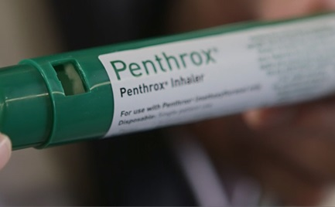
CASE STUDY
Penthrox Inhaler
Upscaling production to enter new export markets
Medical Developments International (MDI) is an Australian business that manufactures Penthrox, commonly known as the ‘green whistle’.
Penthrox is used by medical practitioners, the defence forces, ambulance and surf lifesaving services to administer emergency pain relief.
CSIRO recently partnered to develop a new process that significantly reduces the cost of producing Penthrox, allowing MDI to grow production of the product by ten-fold.
This partnership has supported MDI’s plan to enter global markets, with the company recently gaining initial regulatory approval for the sale of Penthrox in Europe and the UK.
Medical Development International (MDI) and CSIRO have been working together for more than 15 years.
CSIRO helped MDI move into the European market by creating a new, scalable and reliable manufacturing process for their Penthrox 'green whistle' pain-relieving drug.

Slide 7
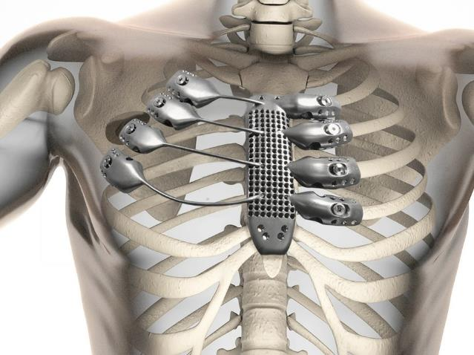
CASE STUDY
Enabling world-first surgery through 3D printing
A 61 year old English man suffering from a rare infection in his sternum was the first to receive a surgically implanted 3D printed titanium and polymer sternum in his chest.
The patient has made a full recovery and success was determined when motion caption cameras showed Edward’s ribs moving in and out, in synchrony with his breathing.
Anatomics, a Melbourne-based biomedical company, designed and manufactured the device out of titanium using CSIRO’s 3D printing expertise and Lab 22 facility.
Anatomics later added the polymer, called ‘Porestar’ which replicates the tissue and cartilage of the human body.

Slide 8
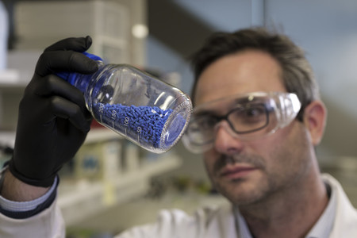
CASE STUDY
Purification of industrial gas streams
Industrial gas streams are often contaminated with multiple different components that must be separated to purify the gas stream. The current systems are large and place a significant energy demand on gas production.
Using CSIRO’s metal organic frameworks (MOF) technology, CSIRO is developing an energy efficient, more compact method to purify hydrogen from a mixture of gases including carbon dioxide and other contaminants.
The sponge-like material makes it possible to store, separate, release or protect valuable commodities, enabling companies to develop high value products.
  This research could result in the development of new compact, highly-energy efficient separation systems for industrial gas streams.
Chemists worldwide use significant energy in purifying and separating chemicals prior to generating everyday products.
It is estimated that the systems involved in separation and purification processes use 10 to 15 per cent of the world’s energy ¹.
1 Nature, vol532, Issue 7600/Comment

